Slide 1

H2O Machine Learning & Deep Learning London Workshop
Jo-fai (Joe) Chow
Data Scientist
joe@h2o.ai
@matlabulous
Data Science for IoT Meetup
Barclays Eagle Venture Labs
21st & 24th November, 2016

Slide 2
Download Data & Code for Workshop
Please go to bit.ly/h2o_iot_workshop1

Slide 3
Example 1: Classification
(Use Case: Predictive Maintenance)

Slide 4
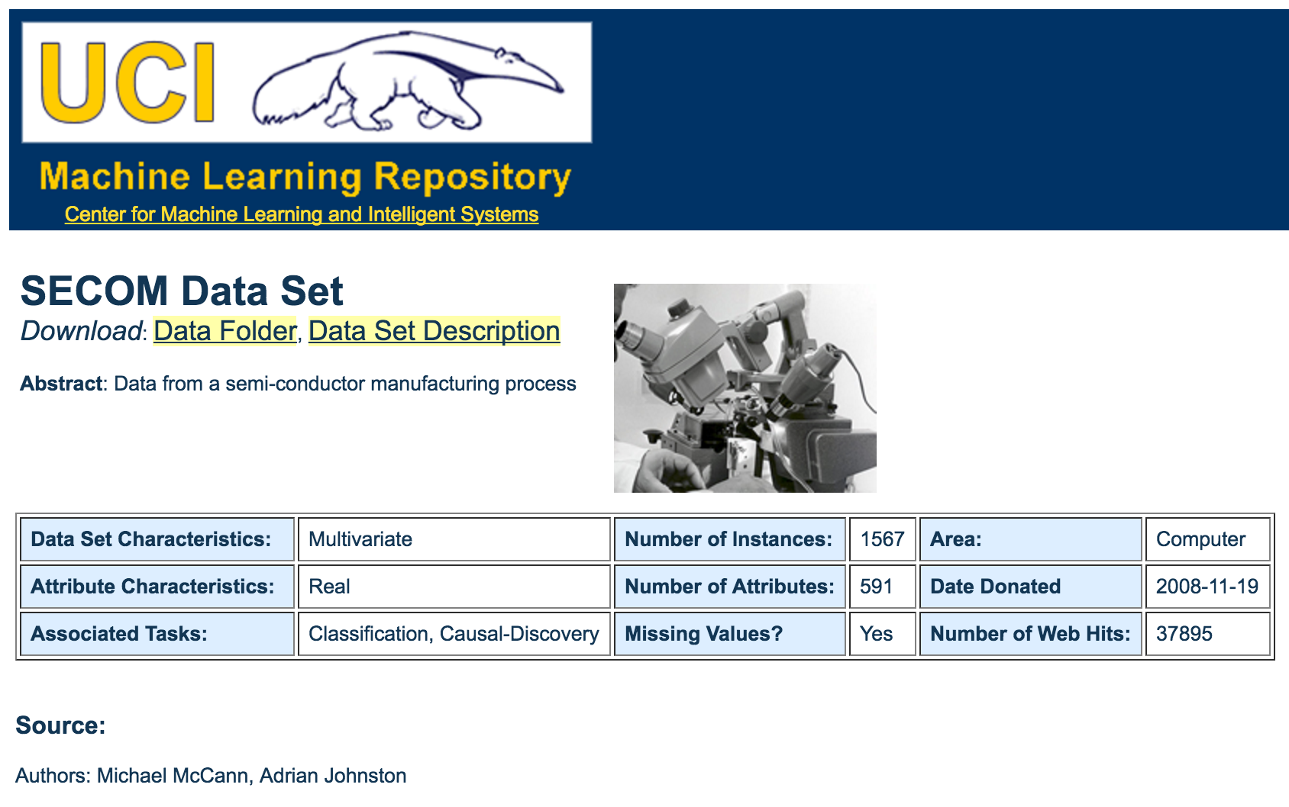
Data for Use Case 1: SECOM
https://archive.ics.uci.edu/ml/datasets/SECOM

Slide 5
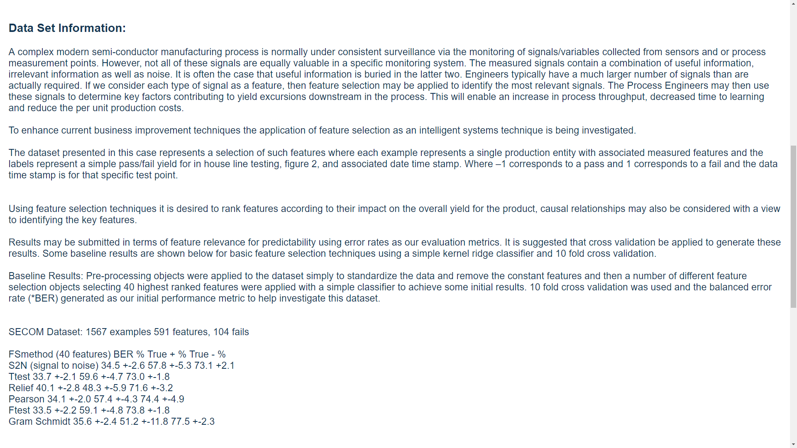
We want to predict fails in the future.

Slide 6
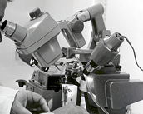
The ML Problem – Pass/Fail
Inputs
591 features
Output
Classification
-1 = pass
1 = fail
Size: 1567 Samples

Slide 7
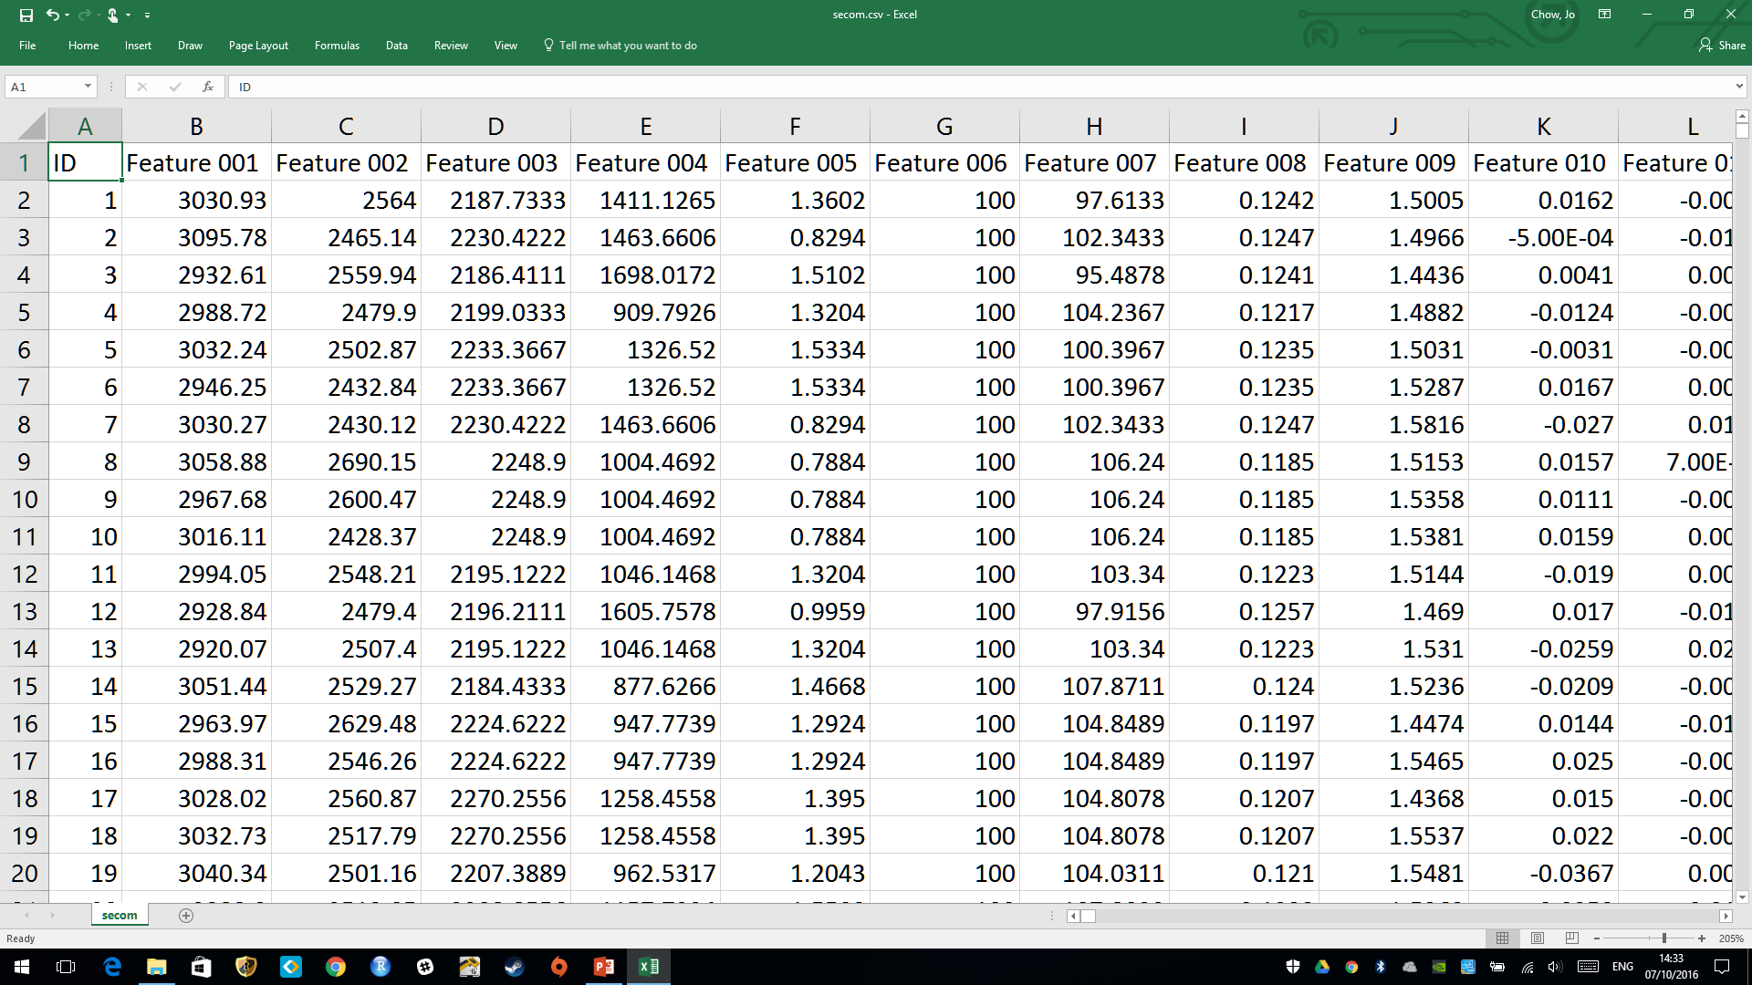
Features (Numeric)
ID (excluded from modeling)

Slide 8
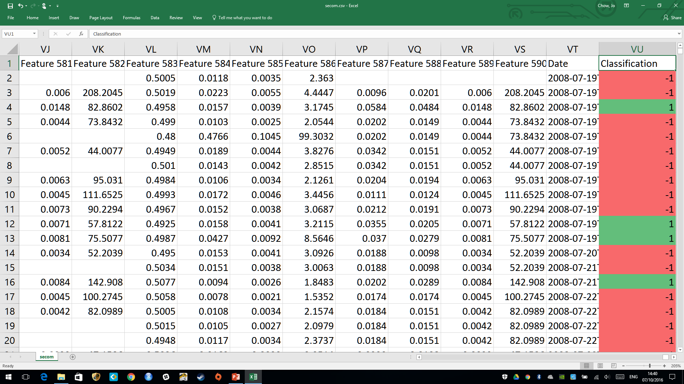
Features (Numeric)
Response (Classification)
-1 (Pass) or 1 (Fail)

Slide 9
Workshop #1
Example 1: Classification
Step 1: R Packages

Slide 10
step_01_install_packages.R

Slide 11
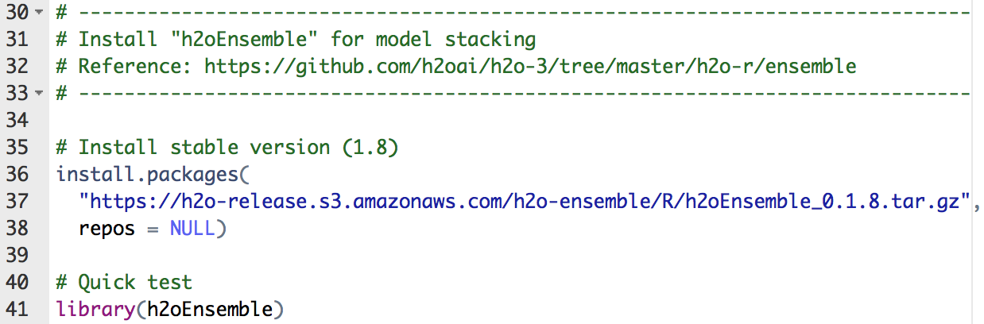
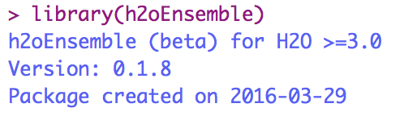
step_01_install_packages.R
Package ‘h2oEnsemble’

Slide 12
Example 1: Classification
Step 2: Exploratory Analysis

Slide 13
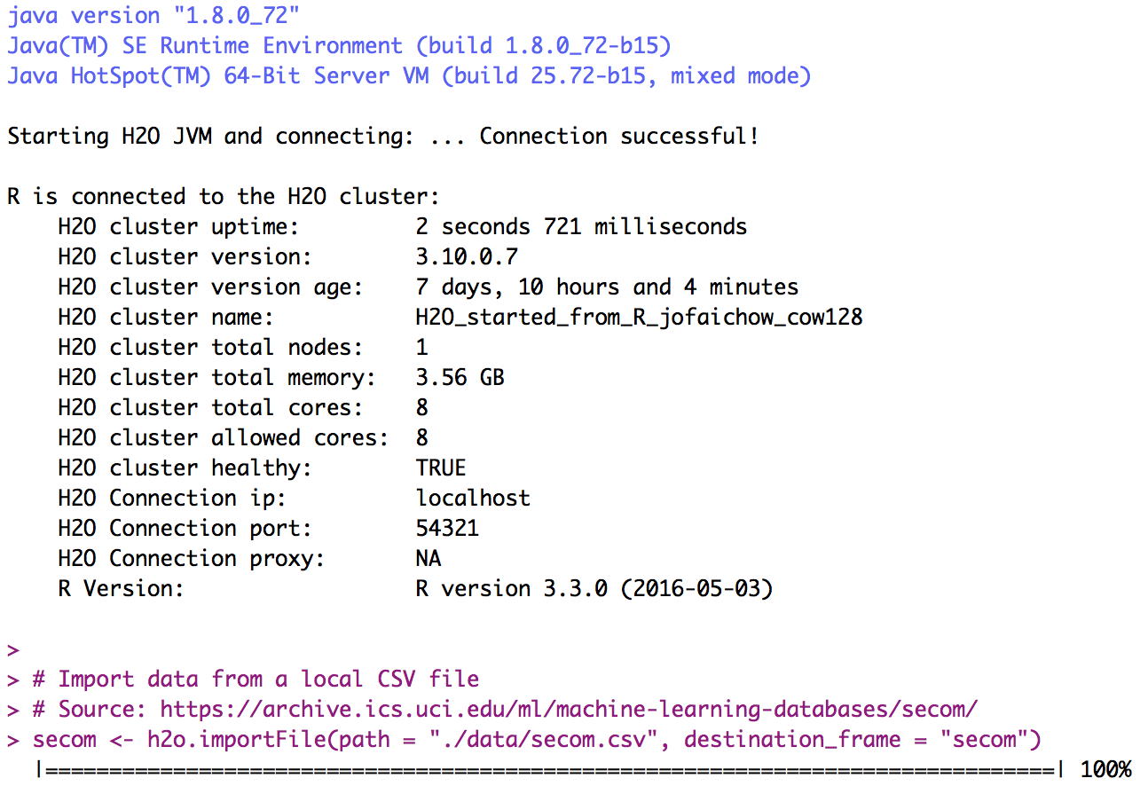
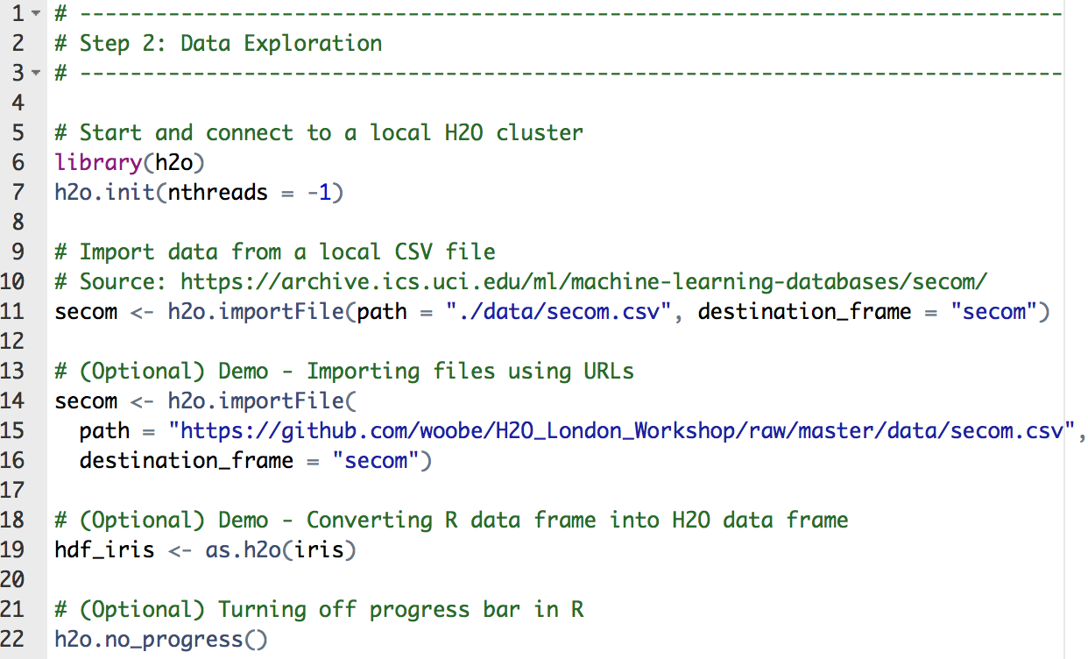
step_02_exploratory_analysis.R
Importing SECOM data
Optional (different ways to import data)

Slide 14
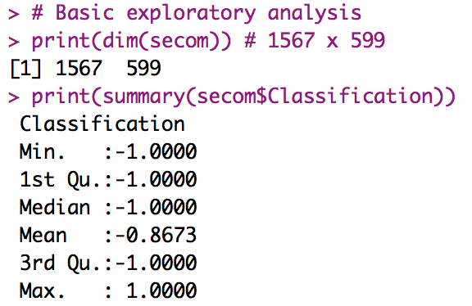
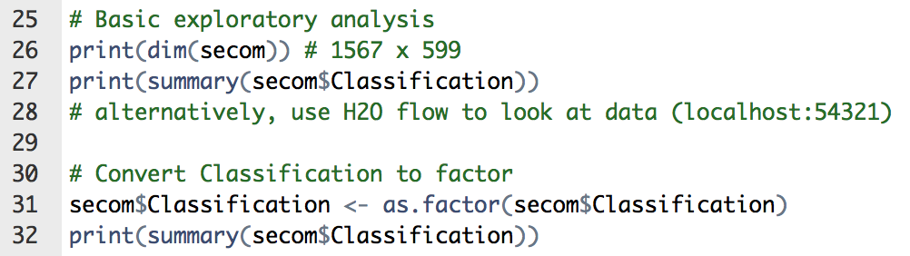
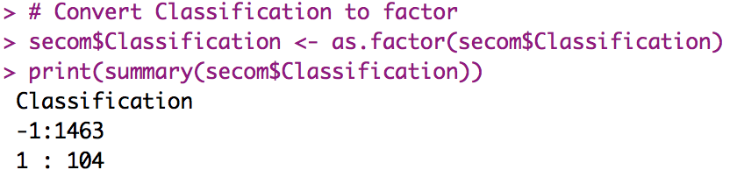
step_02_exploratory_analysis.R
Basic exploratory analysis
Convert -1 and 1 to categorical value

Slide 15
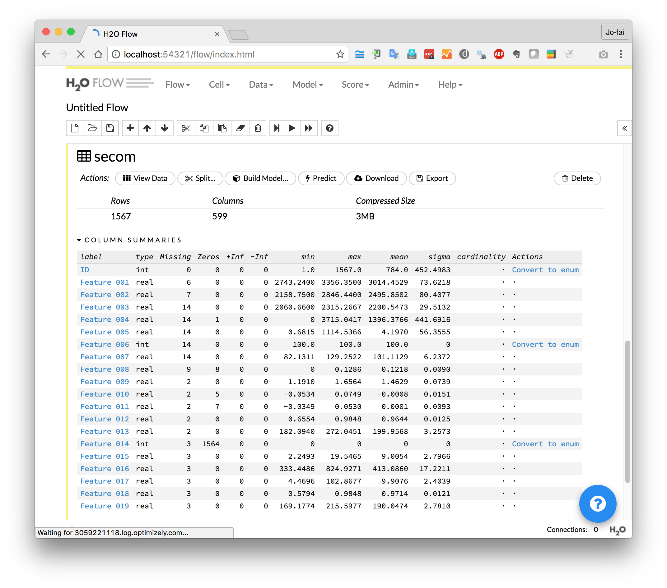
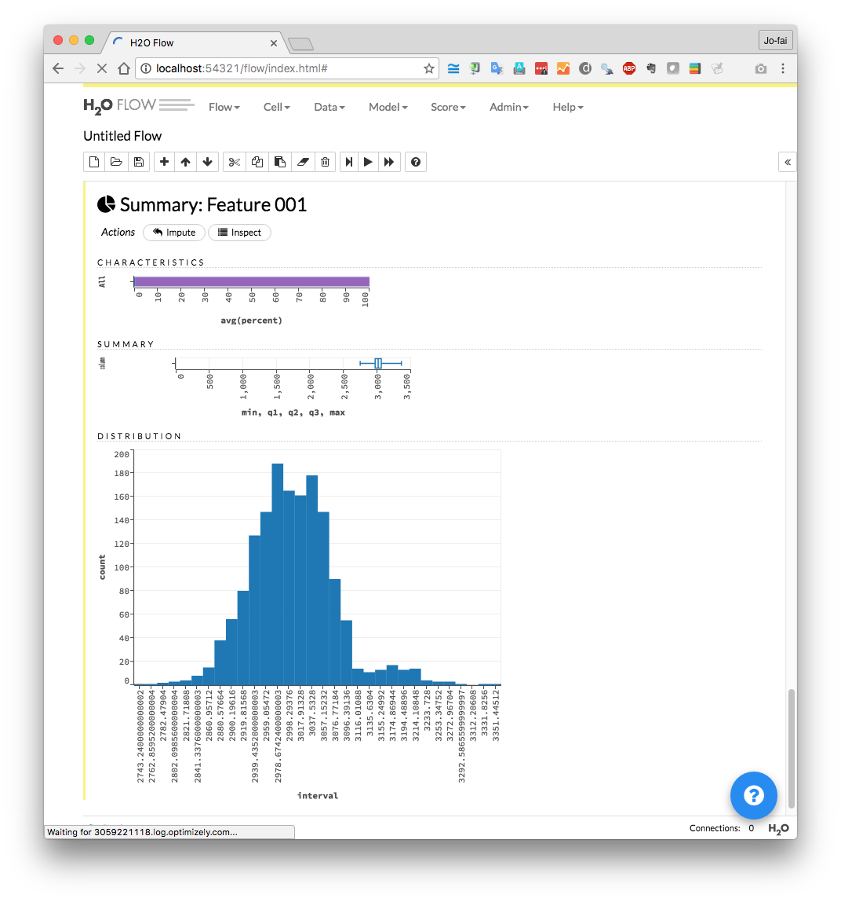
Use H2O Flow (localhost:54321)

Slide 16
Example 1: Classification
Step 3: Building Models

Slide 17
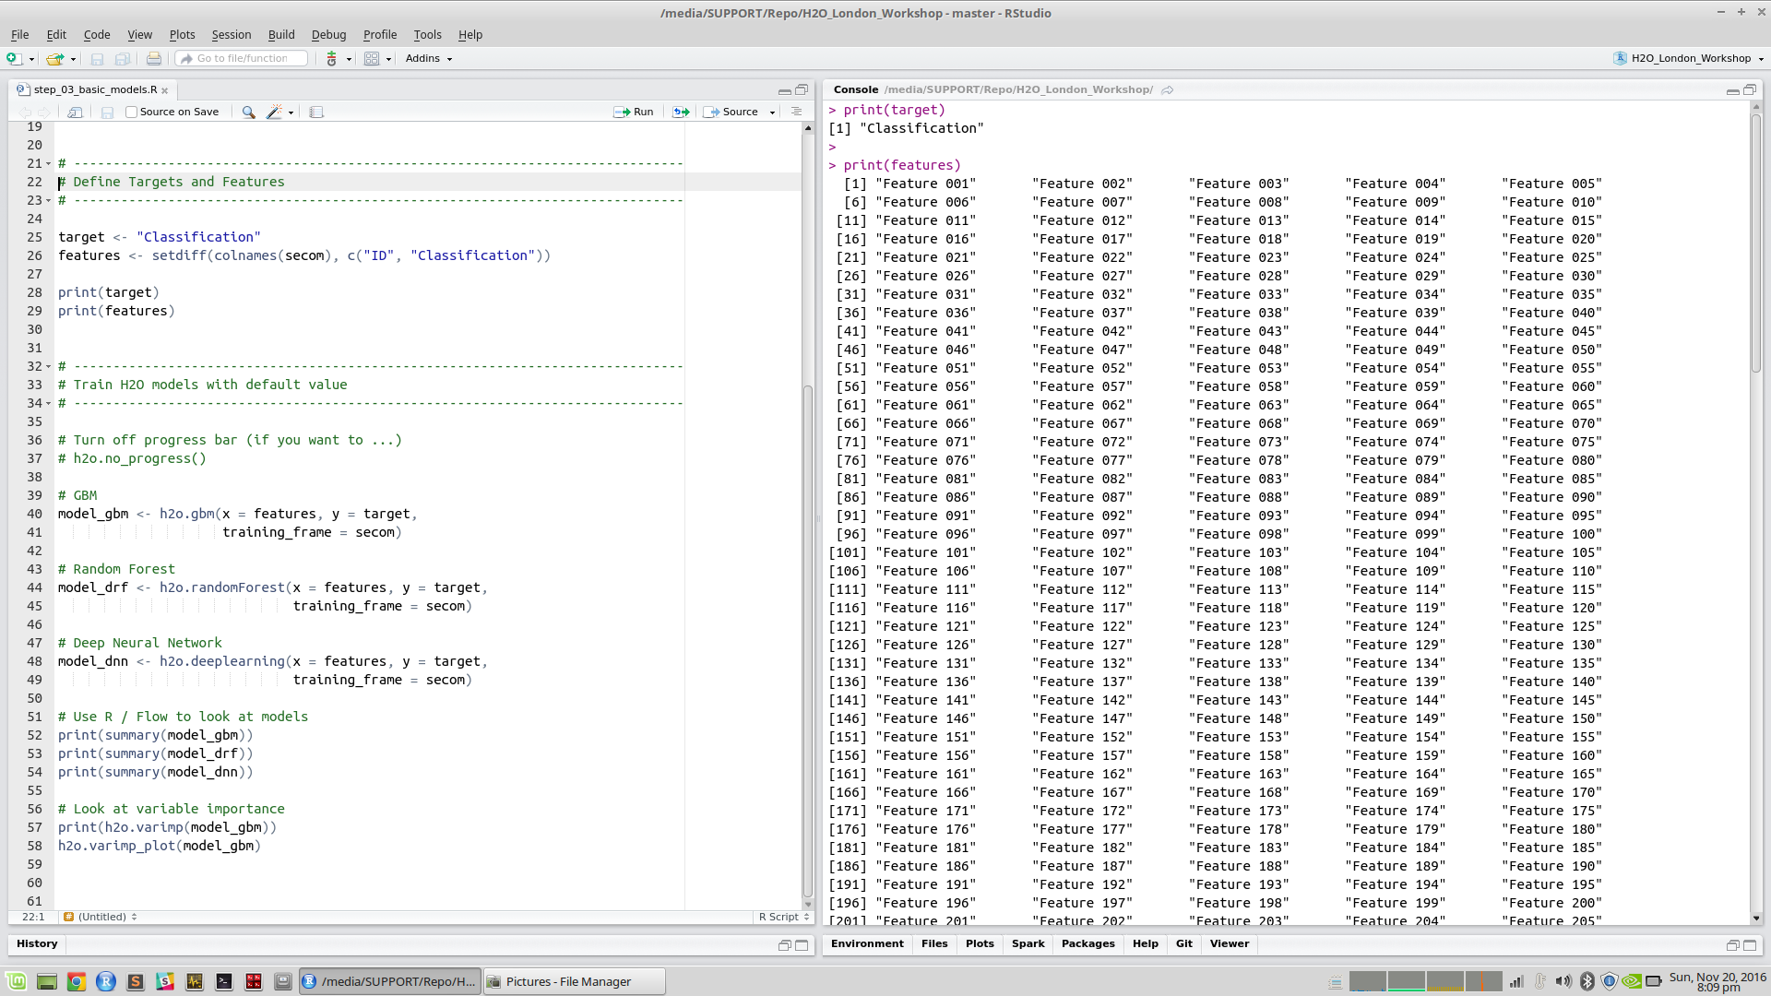
step_03_basic_models.R
Define features & target

Slide 18
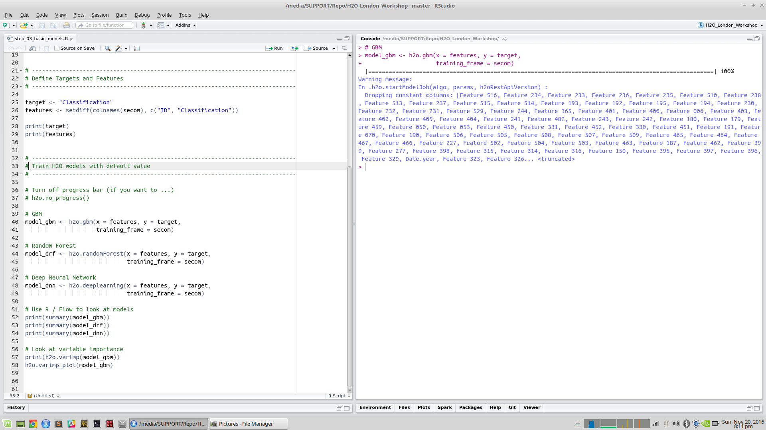

Slide 19
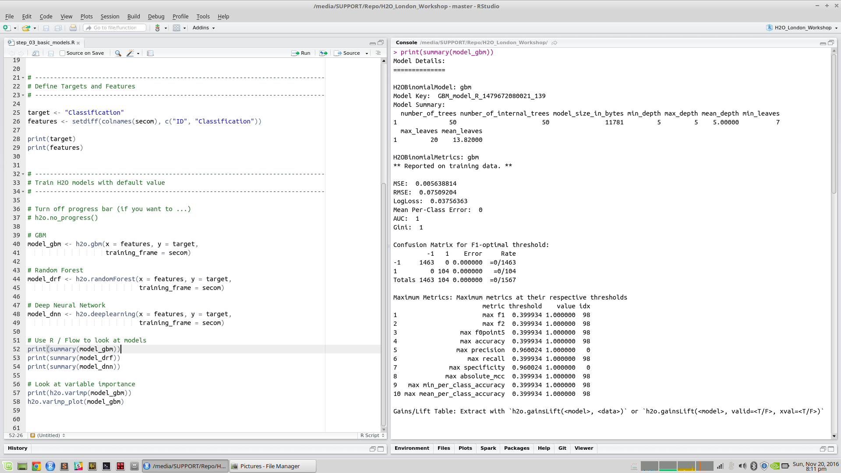

Slide 20
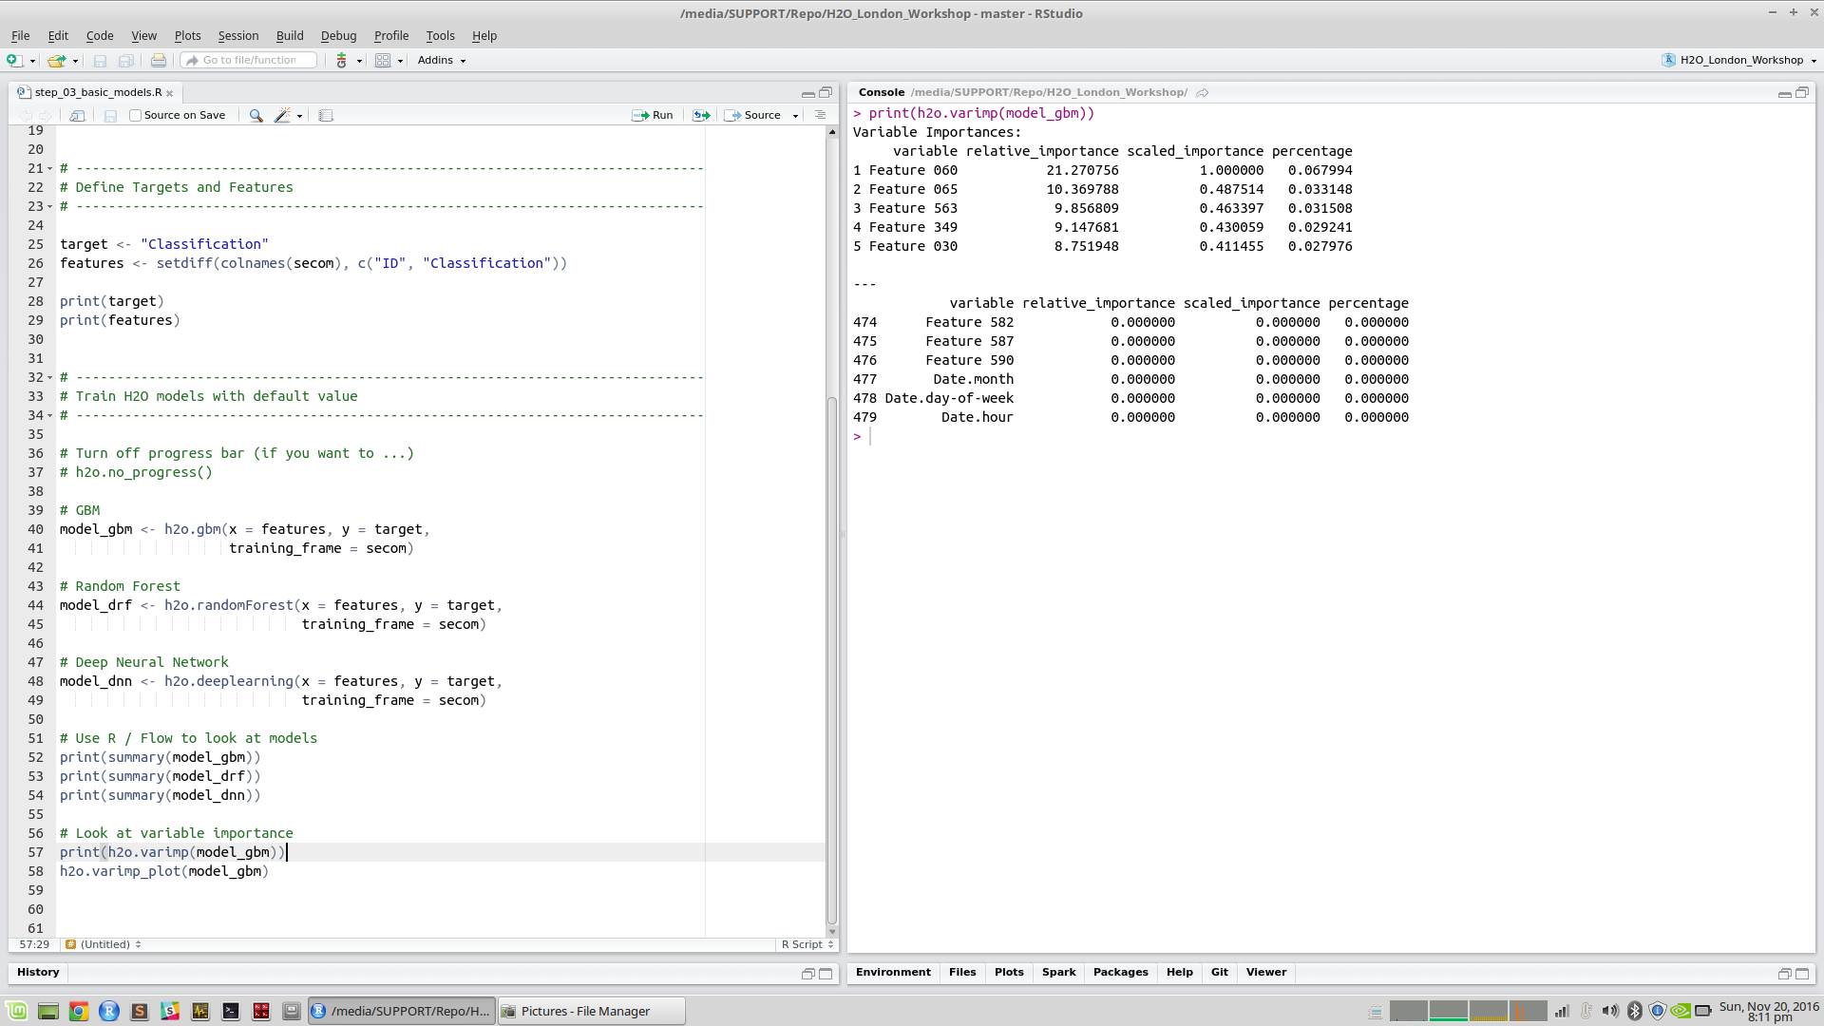

Slide 21
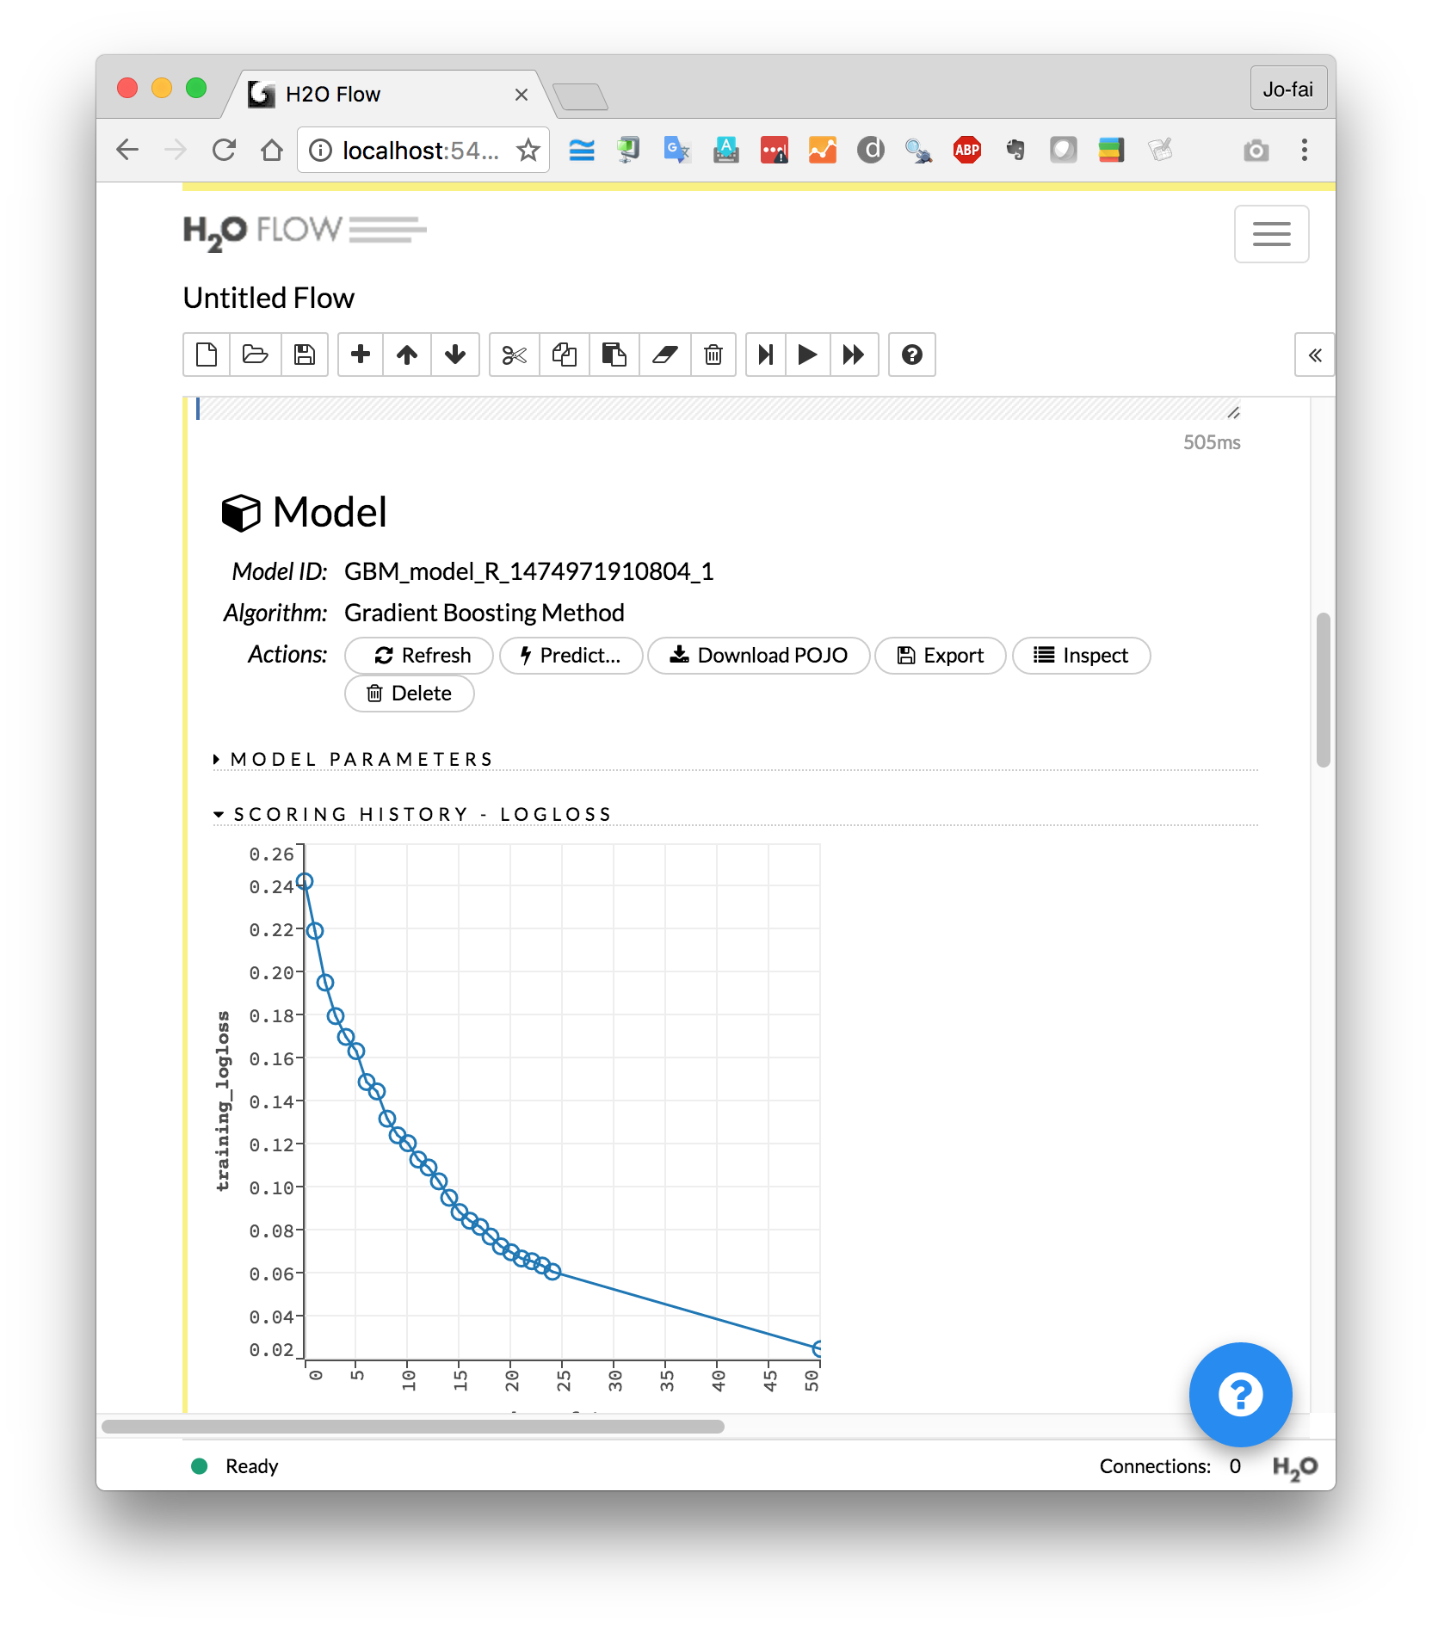
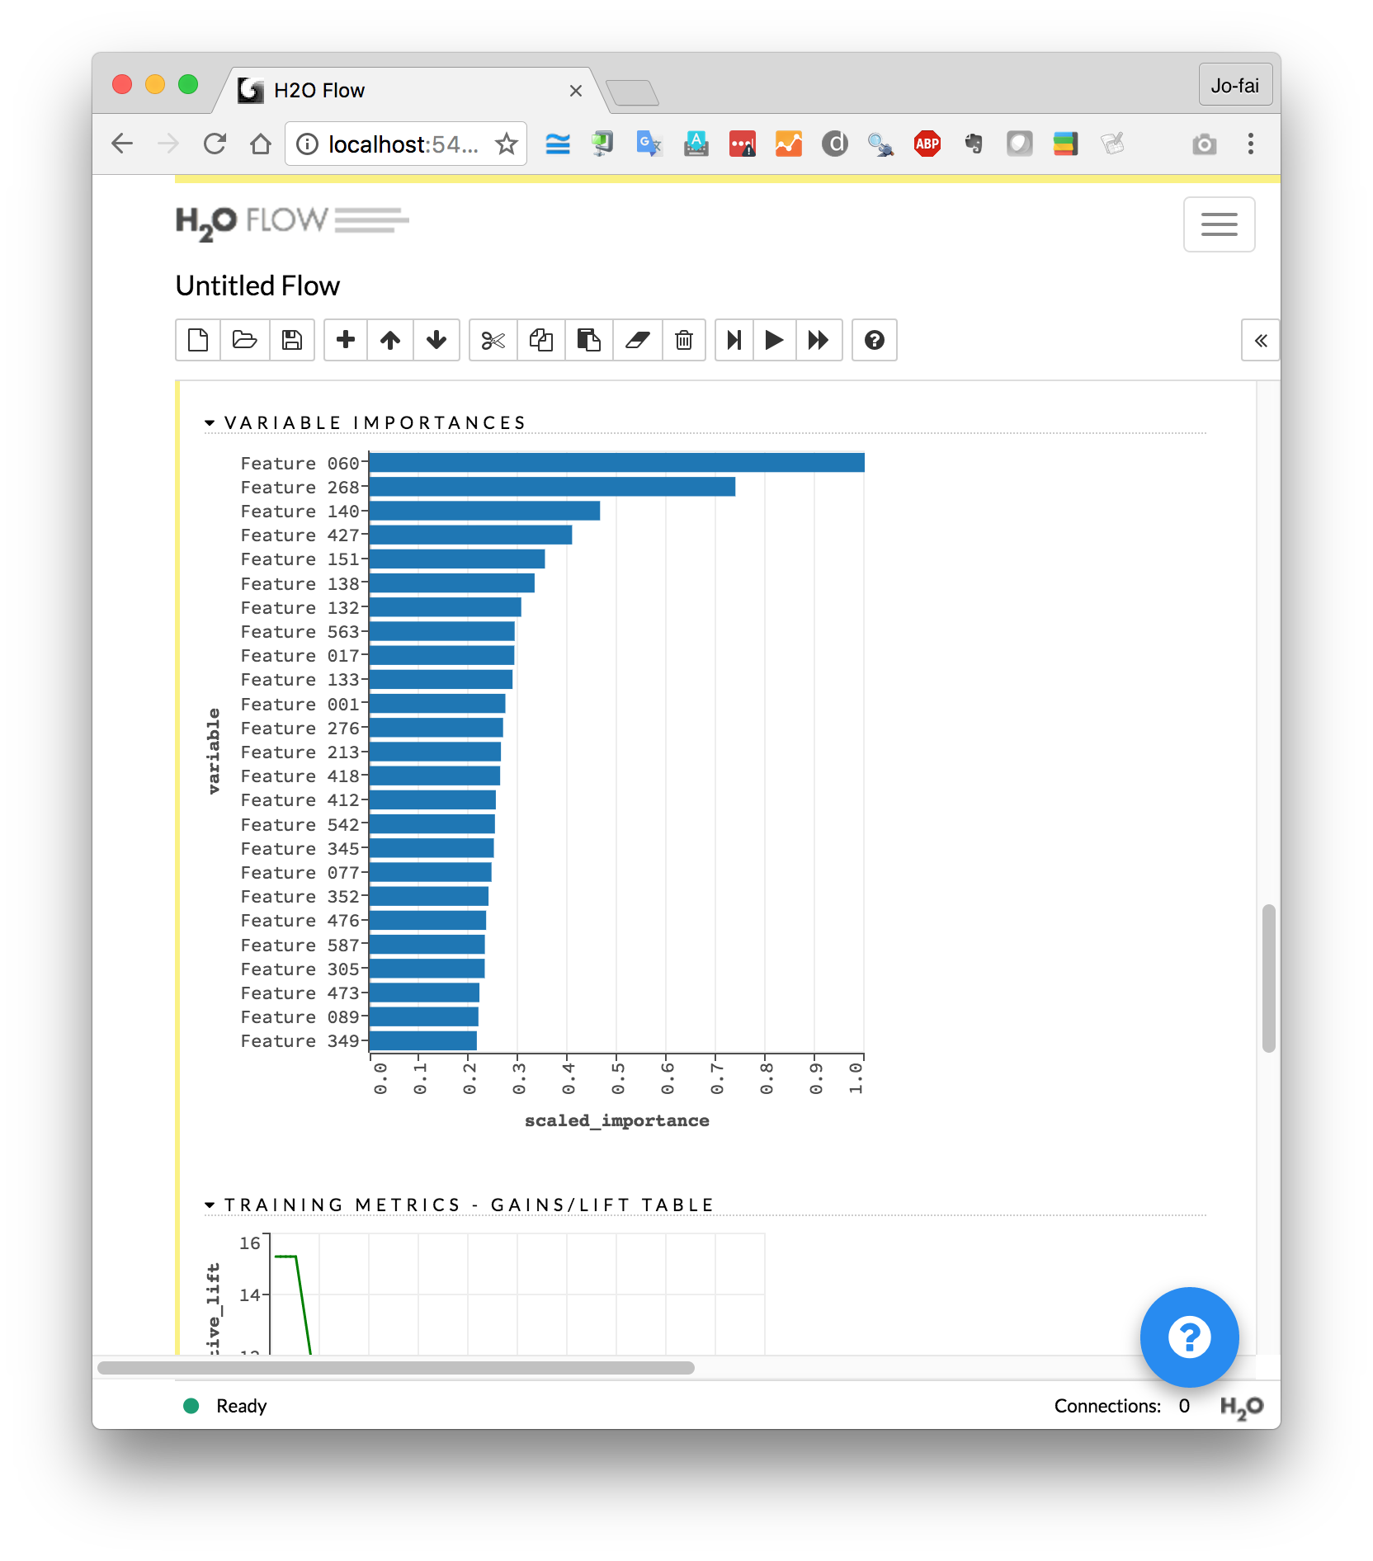
Use H2O Flow (localhost:54321)

Slide 22
Example 1: Classification
Step 4: Evaluating Models

Slide 23
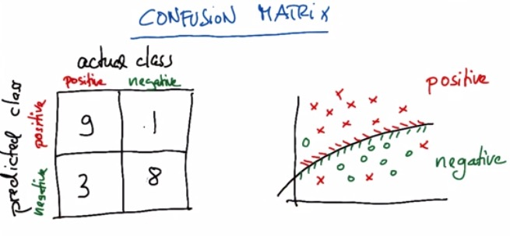
Confusion Matrix

Slide 24
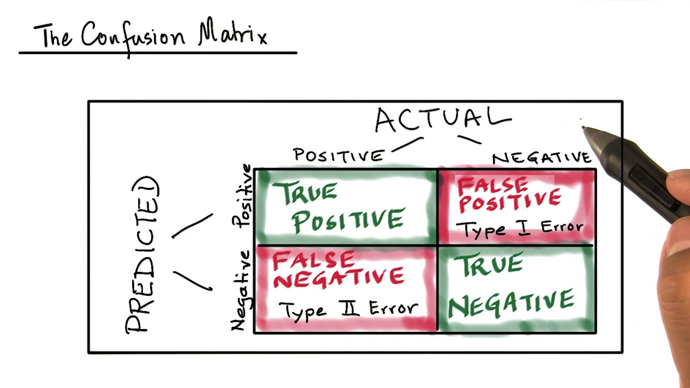

Slide 25
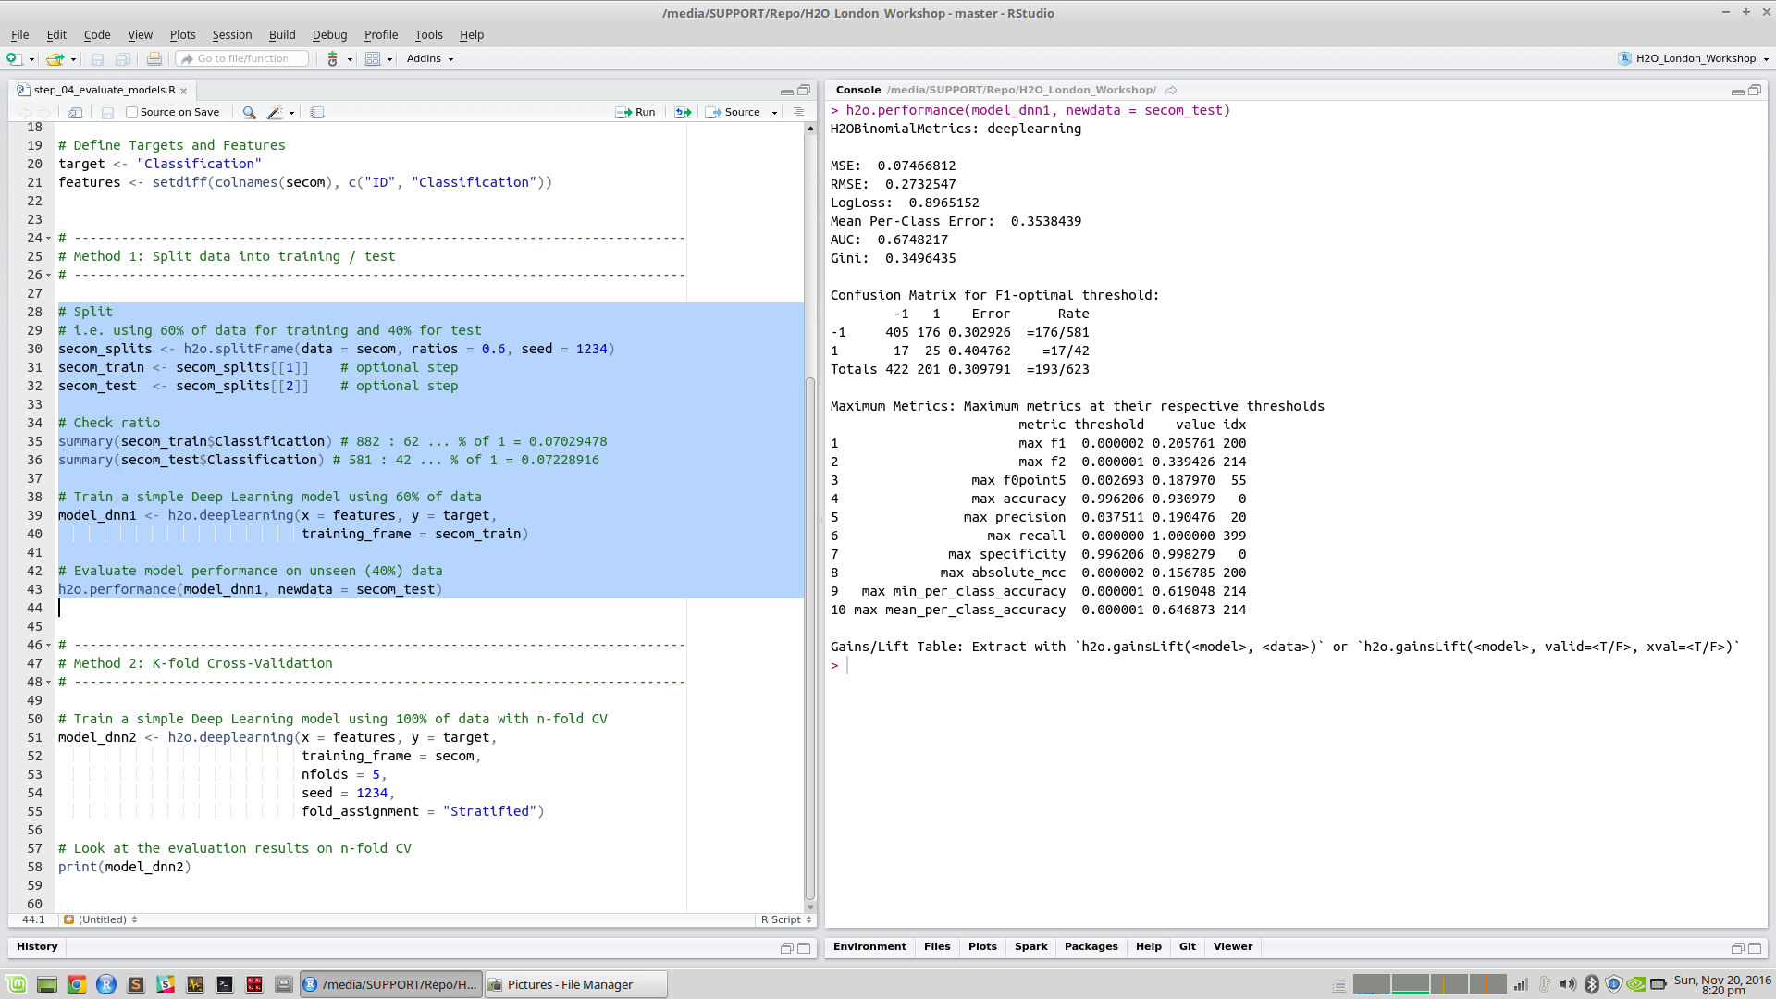

Slide 26
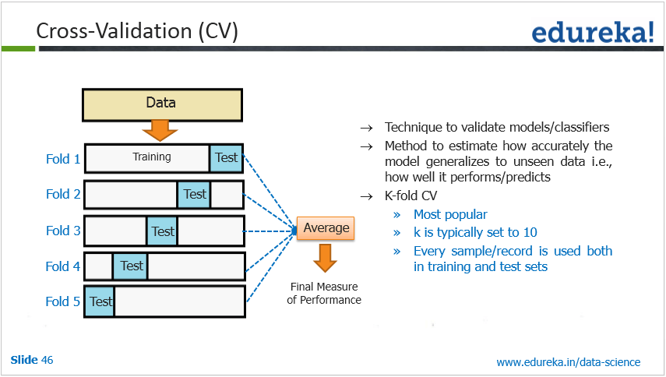
Cross Validation

Slide 27
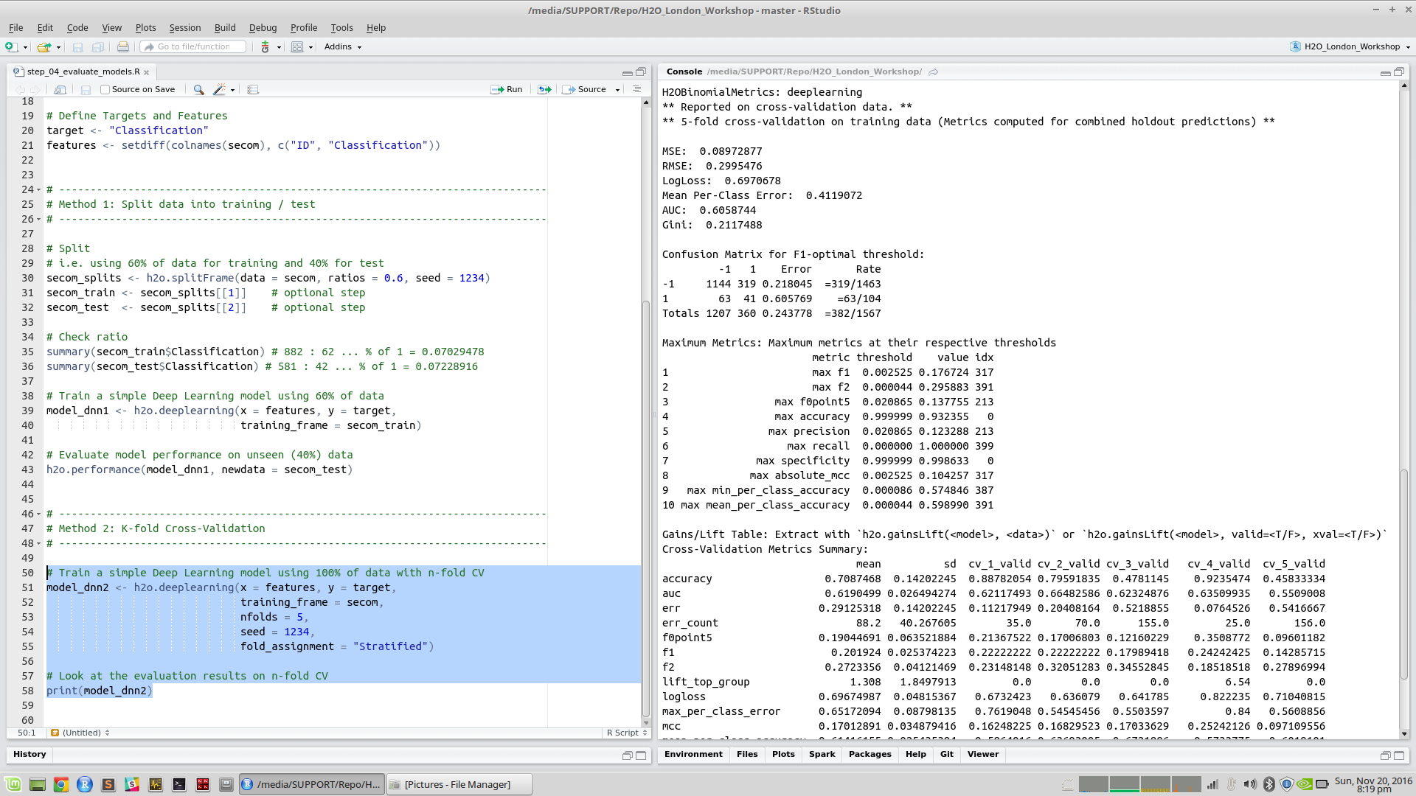

Slide 28
Example 1: Classification
Step 5: Tuning Models

Slide 29
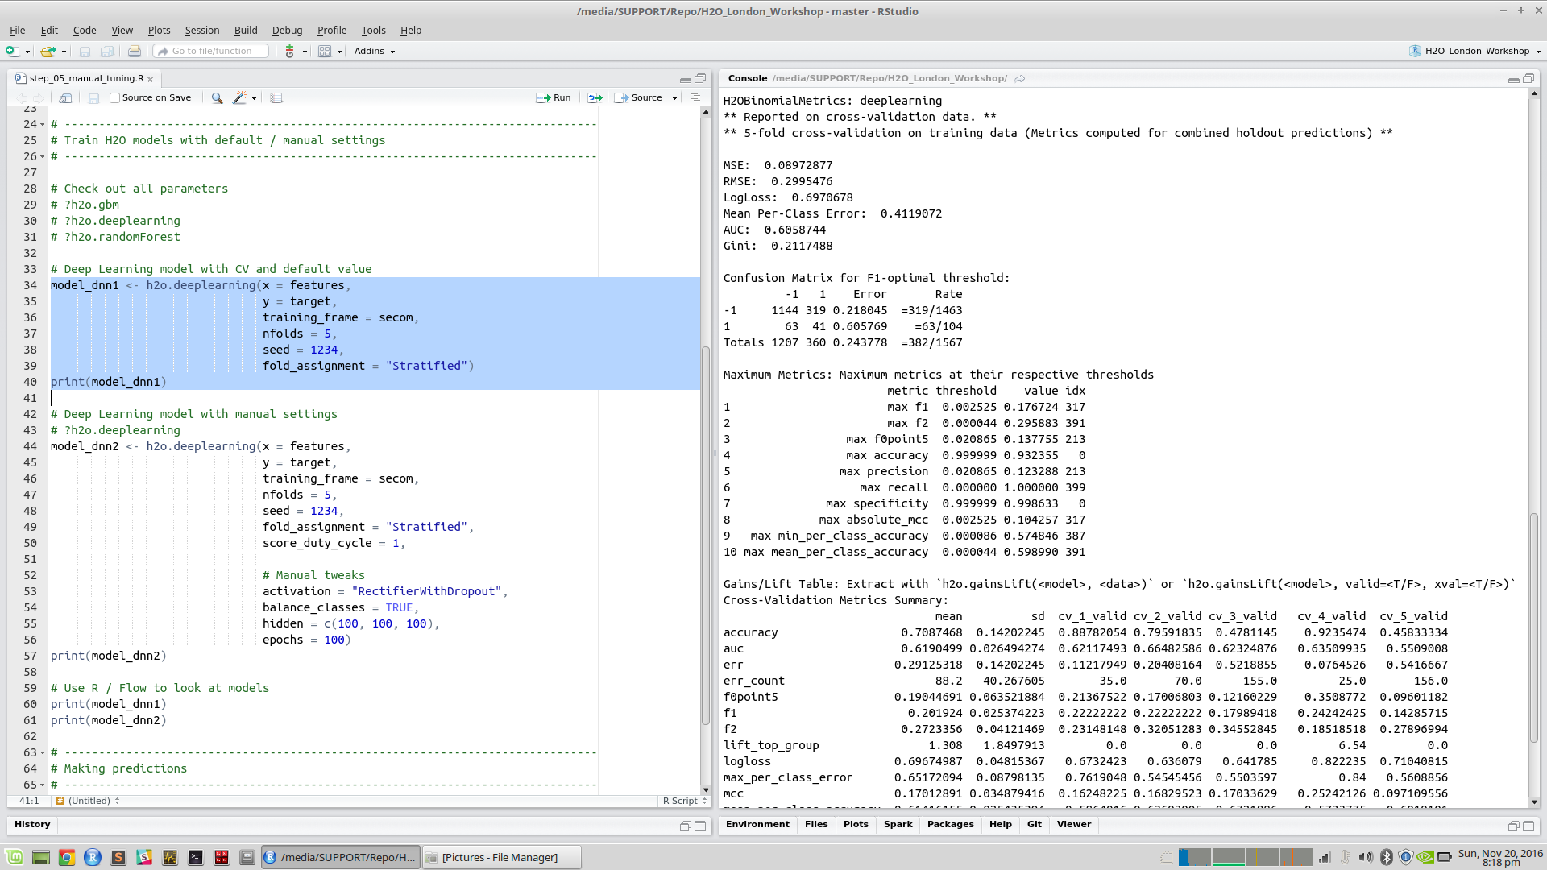

Slide 30
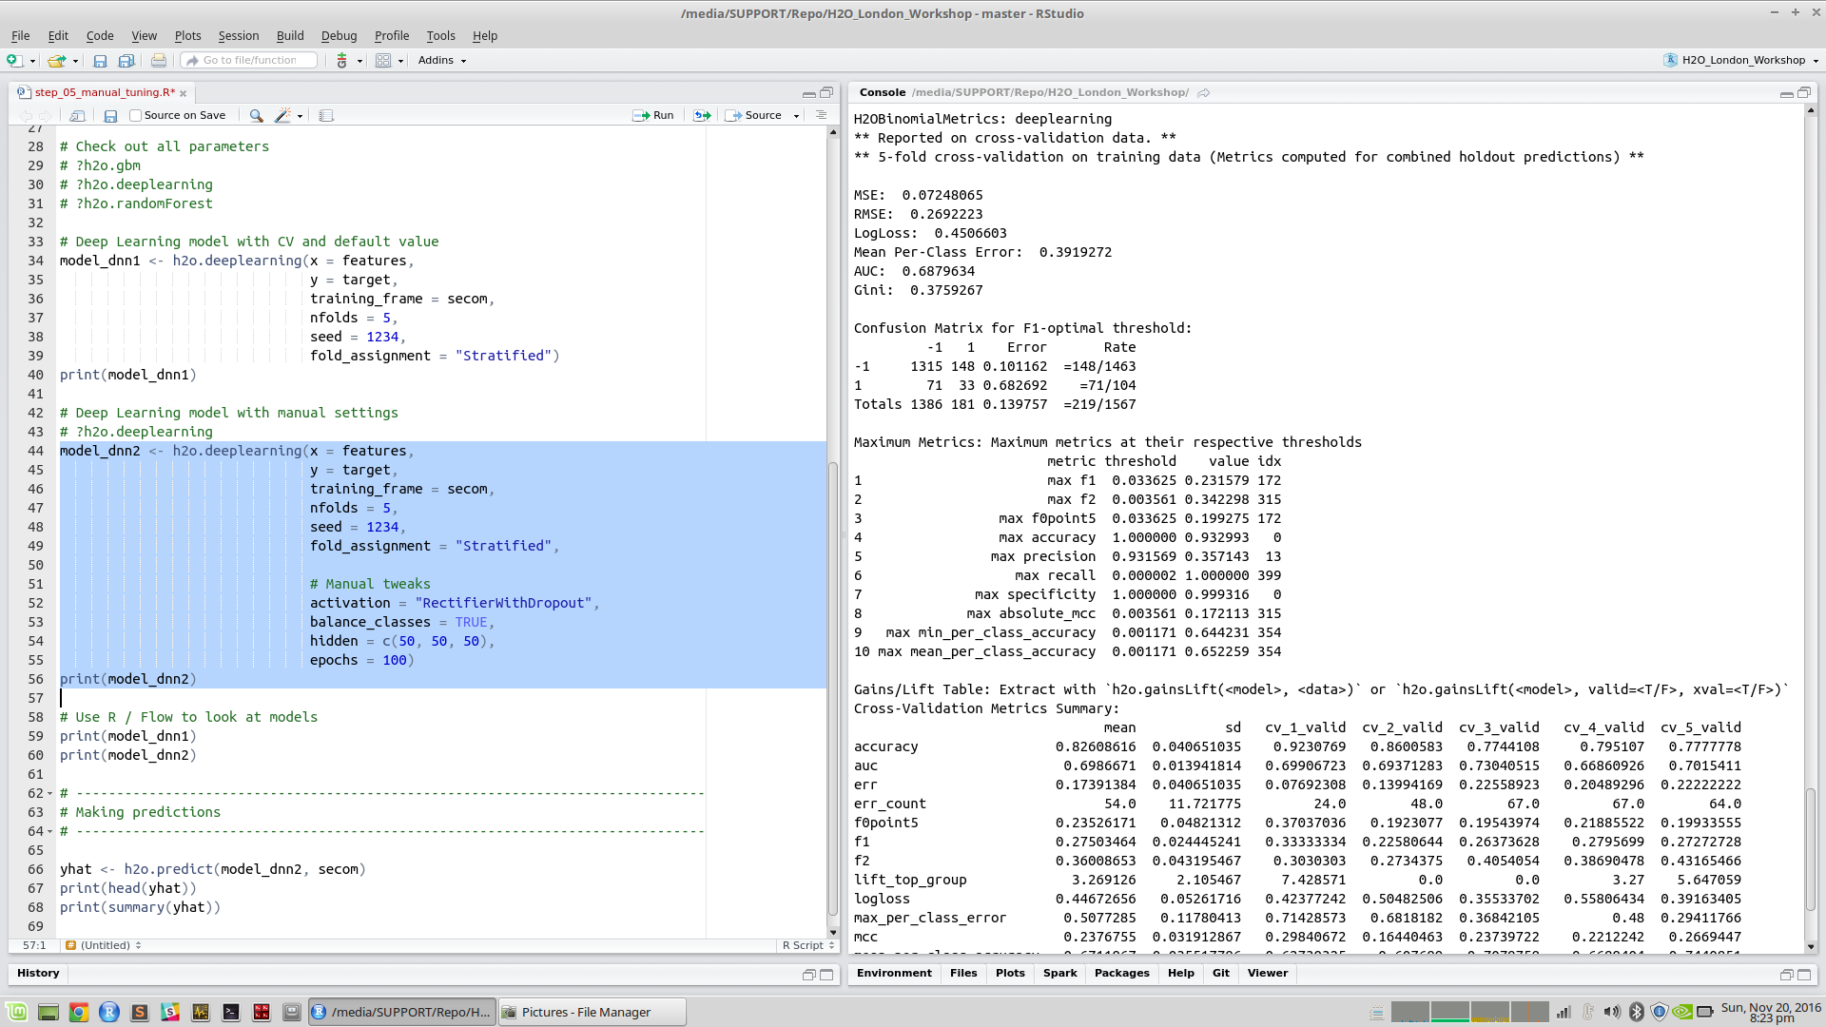

Slide 31
Comparison: Default vs. Manual
Default Settings
Manual Tweaks
Smaller Errors
Fewer false positives

Slide 32
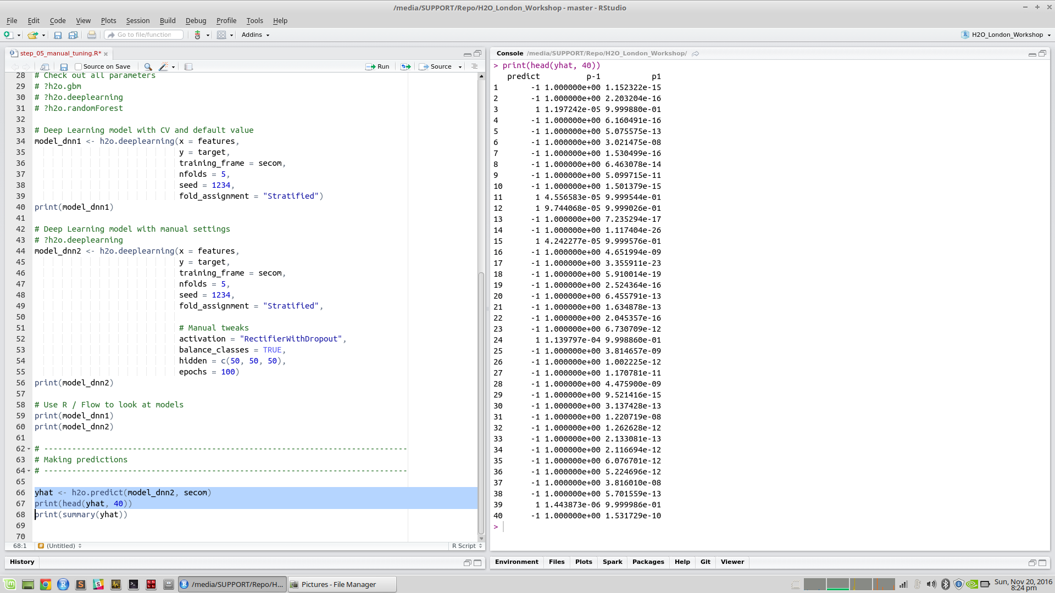
Making Predictions

Slide 33
End of Workshop #1
(to be continued …)

Slide 34
Workshop #1 Recap

Slide 35
Workshop #1 Recap
Introduction to H2O
H2O’s Interface
Flow (Web) and R
MNIST Example
Hand-written Digits
28 x 28 Pixels
Labels: 0 to 9
Example 1
SECOM Data
591 Features (sensors)
One Output
Pass = -1
Fail = 1
Binary Classification

Slide 36
Workshop #2 Agenda
Example 1 (cont’d)
Full/Random Grid Search
Model Stacking
Saving/Loading Models
Deploying Models with H2O Steam
Example 2
Anomaly Detection using Deep Auto Encoder
Deep Water
Motivation
Demo

Slide 37
Early Stopping and Grid Search

Slide 38
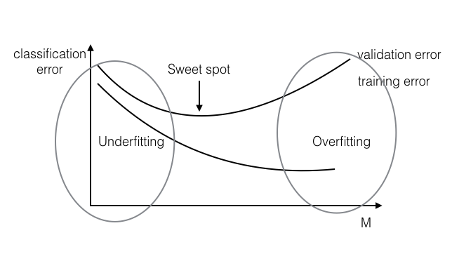
Underfitting and Overfitting
Training should stop here

Slide 39
Grid Search
Grid Search Example
Parameter 1
5, 6 and 7
Parameter 2
0.8, 0.9 and 1.0
Full Grid Search
3 x 3 = 9 Combinations
Random Grid Search
Randomly picks n out of 9
 | Parameter 1 | Parameter 2
Model 1 | 5 | 0.8
Model 2 | 5 | 0.9
Model 3 | 5 | 1.0
Model 4 | 6 | 0.8
Model 5 | 6 | 0.9
Model 6 | 6 | 1.0
Model 7 | 7 | 0.8
Model 8 | 7 | 0.9
Model 9 | 7 | 1.0

Slide 40
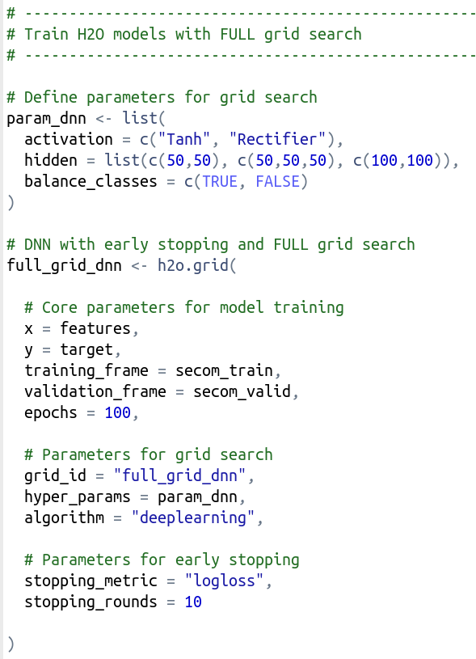
step_06_full_and_random_grid_search.R
Define search range
H2O Grid Search Function
(Default = Full Grid Search)
Core parameters
Define H2O algorithm for gird search
Settings for early stopping

Slide 41
step_06_full_and_random_grid_search.R
Full Grid Search
Comparing logloss from all 12 models

Slide 42
step_06_full_and_random_grid_search.R
Define search criteria for
RANDOM grid search

Slide 43
step_06_full_and_random_grid_search.R
Only searched five models with
RANDOM grid search

Slide 44
h2oEnsemble
Model Stacking

Slide 47
step_07_stacking_models.R
Build three different H2O models

Slide 48
step_07_stacking_models.R
Using h2o.stack(…) function to create ensemble

Slide 49
step_07_stacking_models.R
Ensemble has better performance (e.g. higher AUC) when compared to individual models

Slide 50
Saving / Loading
H2O Models

Slide 51
step_08_saving_loading.R

Slide 52
Deploying Models
with H2O Steam

Slide 53
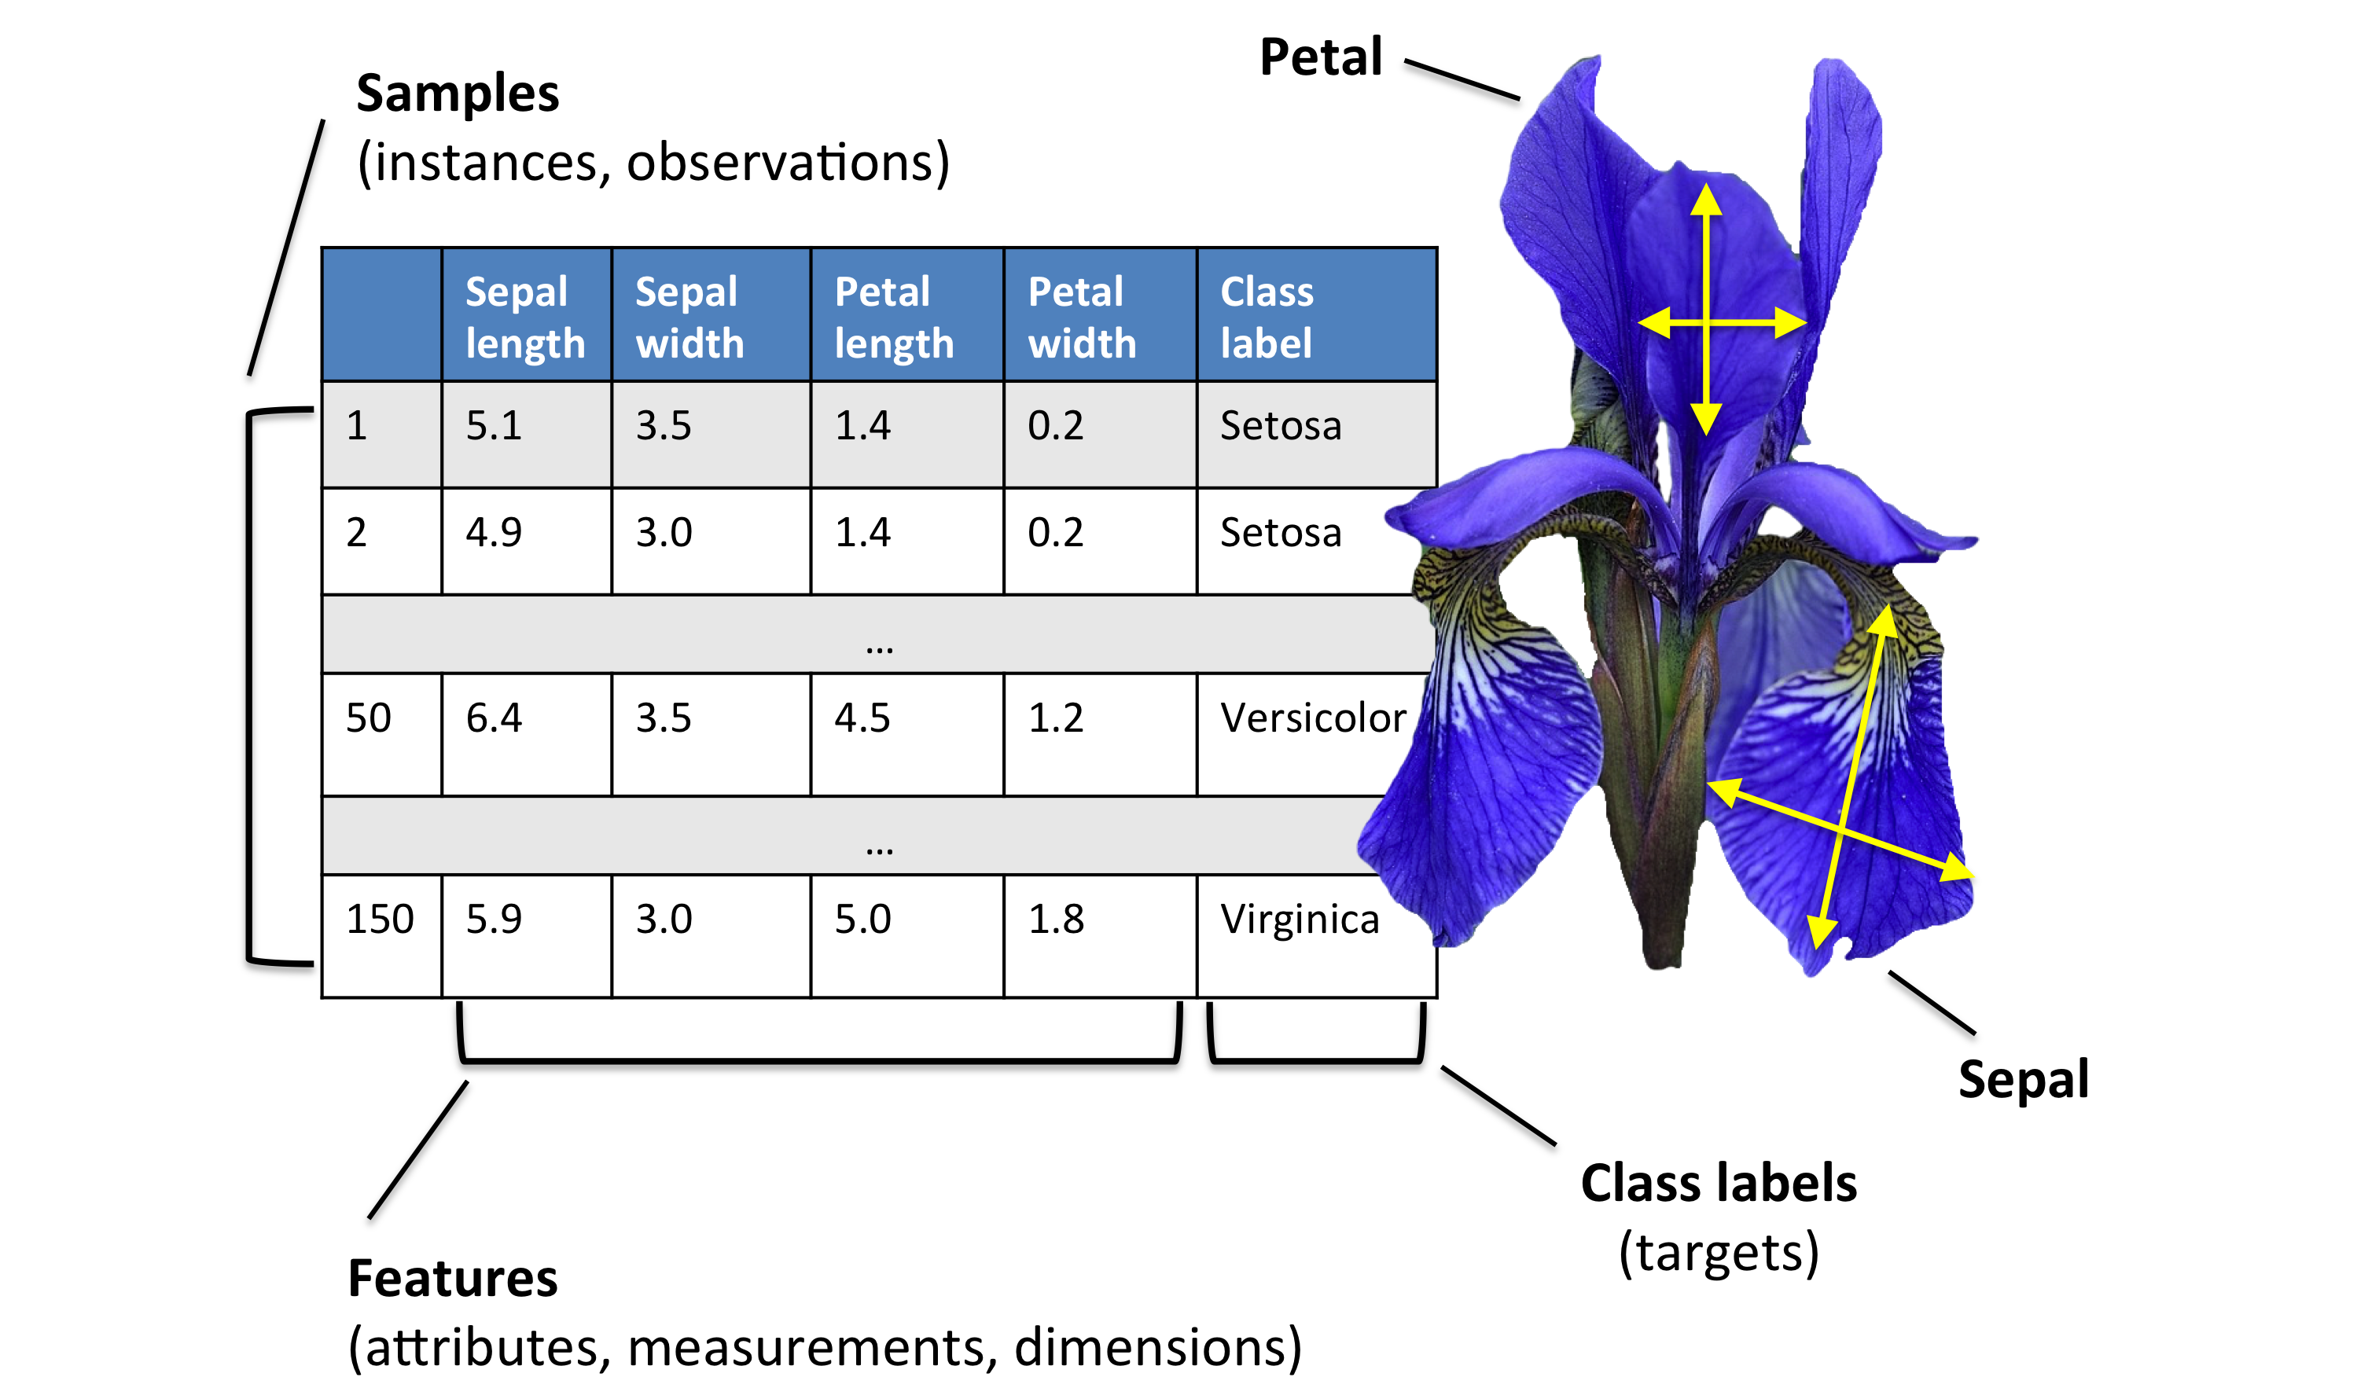
Iris Dataset

Slide 54
step_09_deploy_model_with_steam.R
Build three different models with the classic Iris dataset

Slide 55
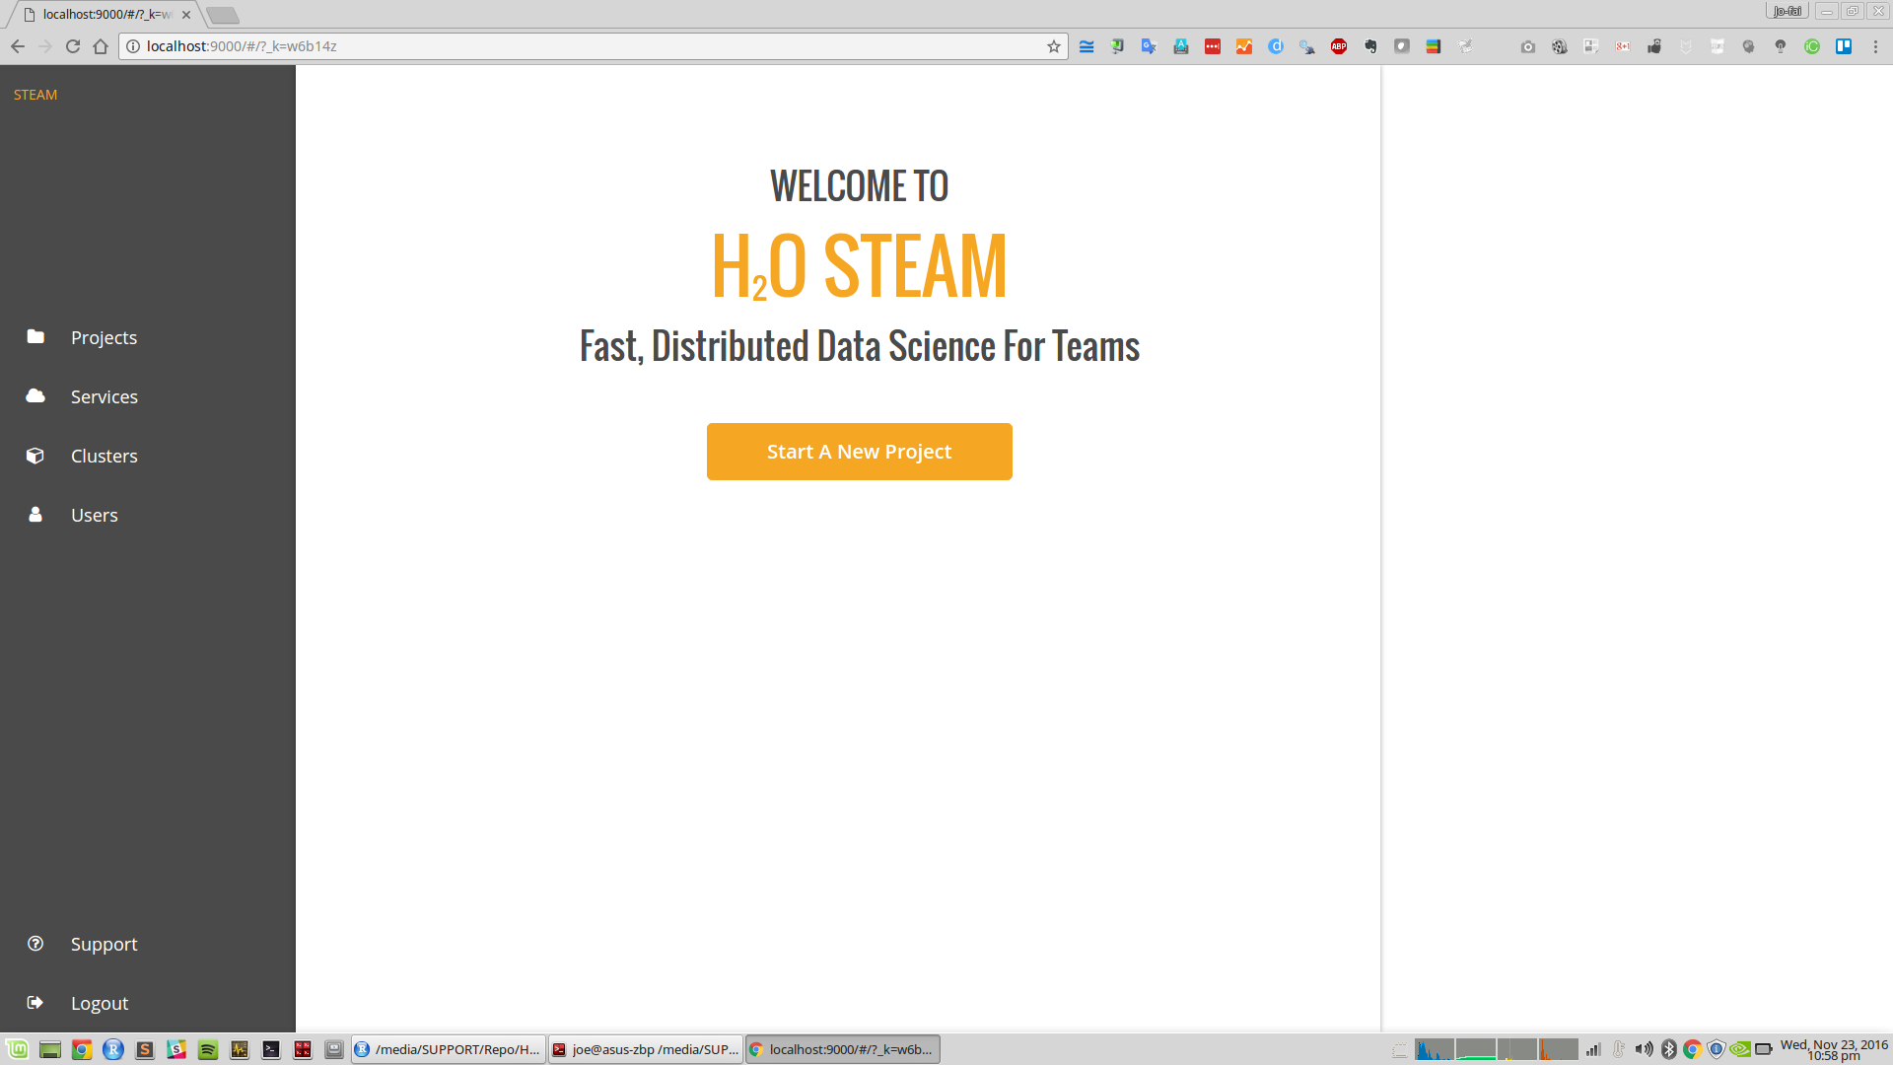
step_09_deploy_model_with_steam.R

Slide 56
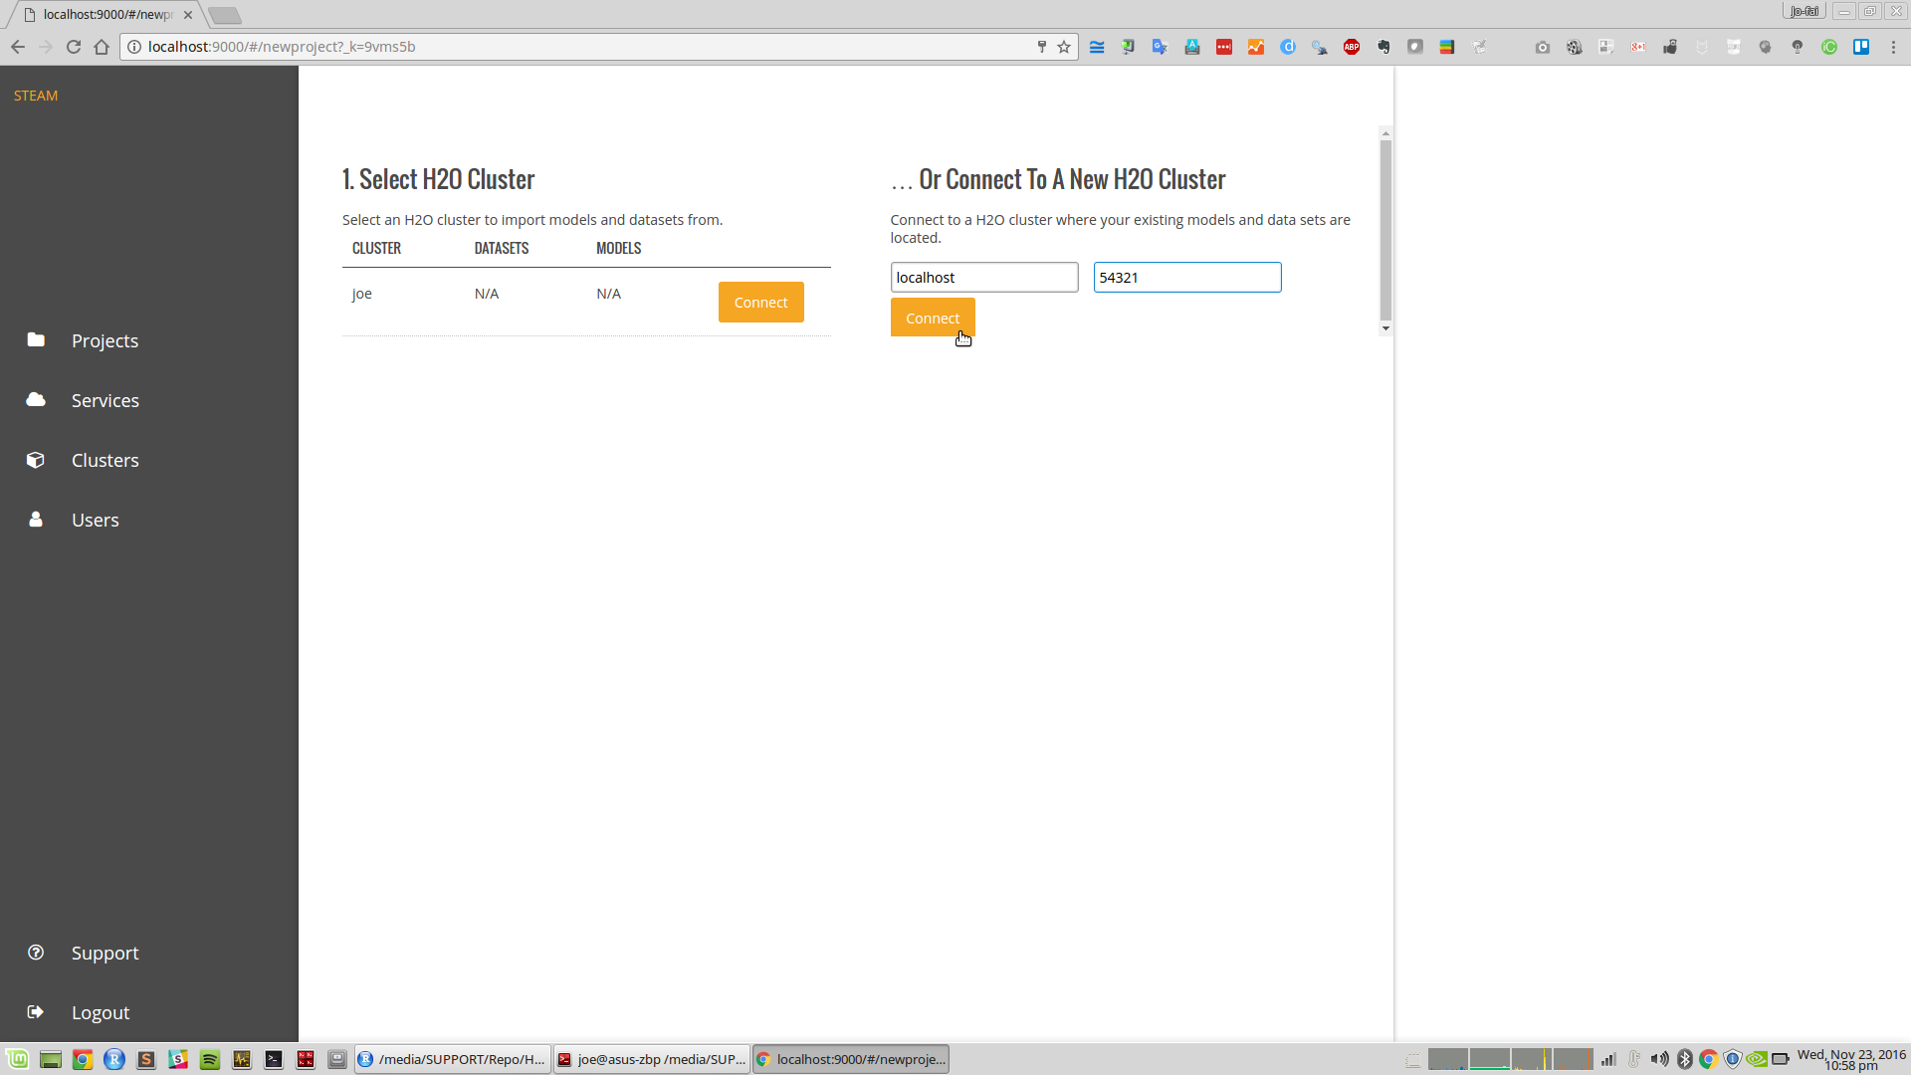

Slide 57
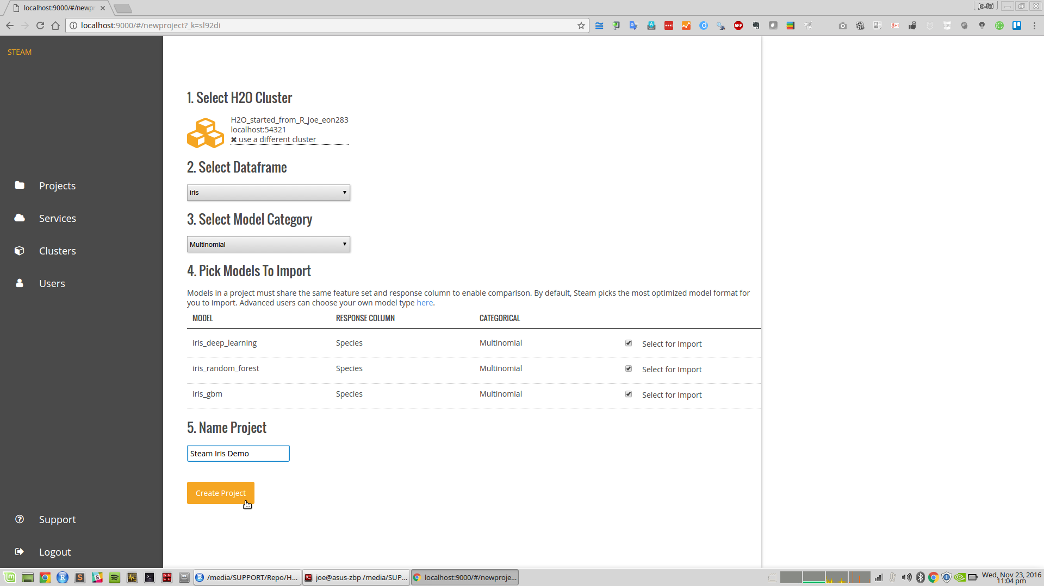

Slide 58
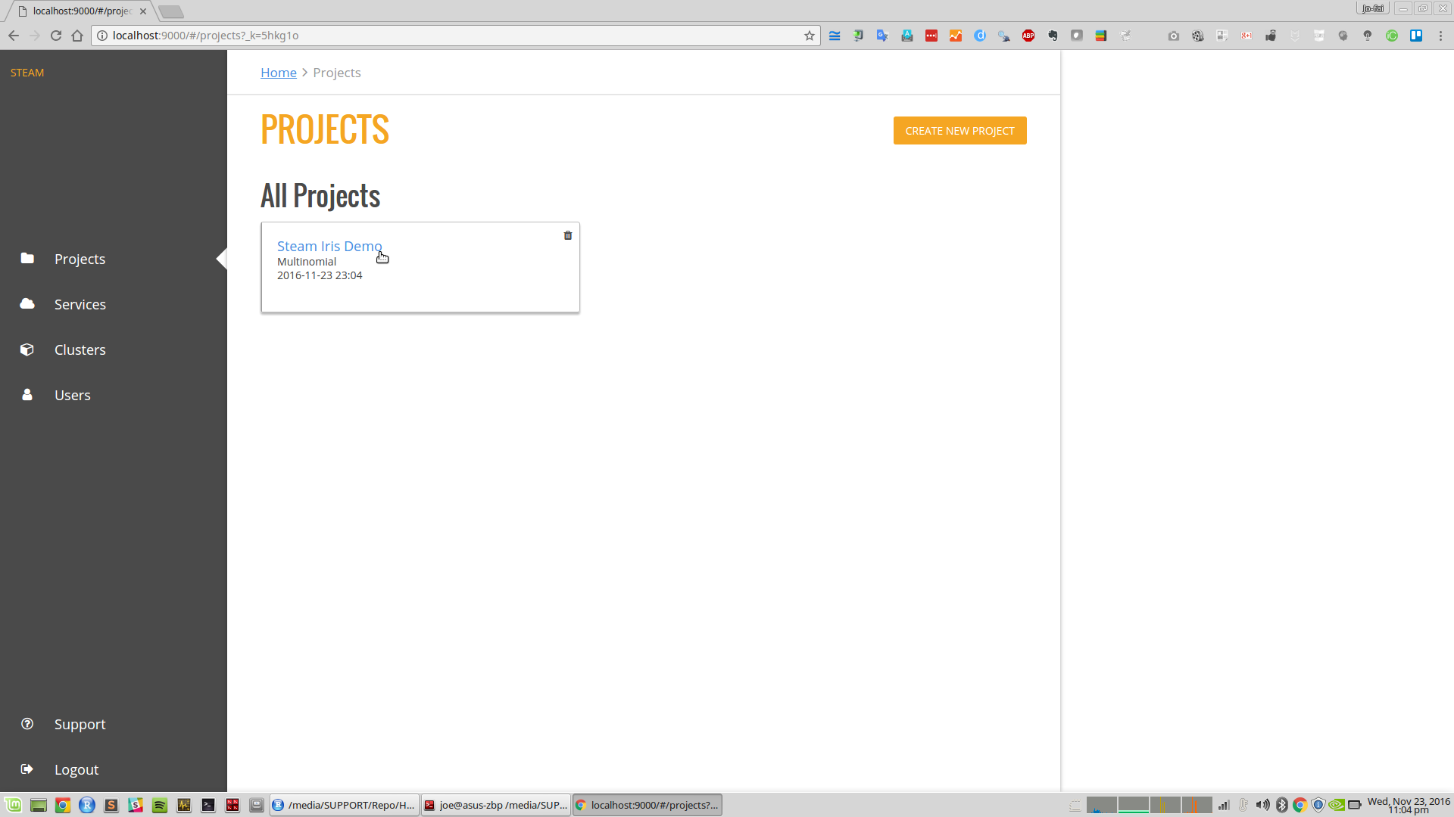

Slide 59
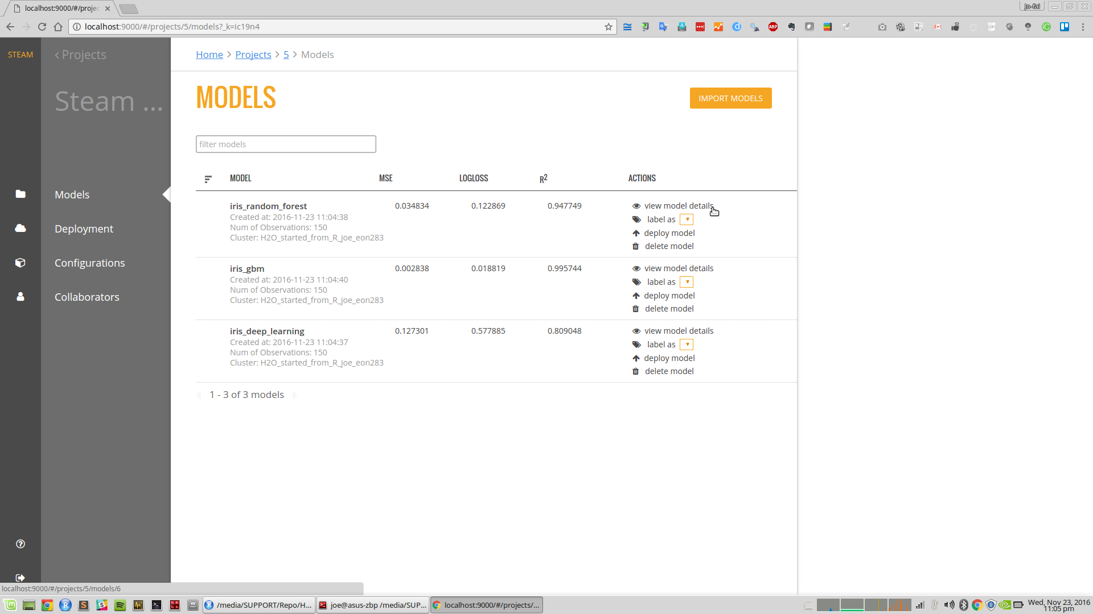

Slide 60
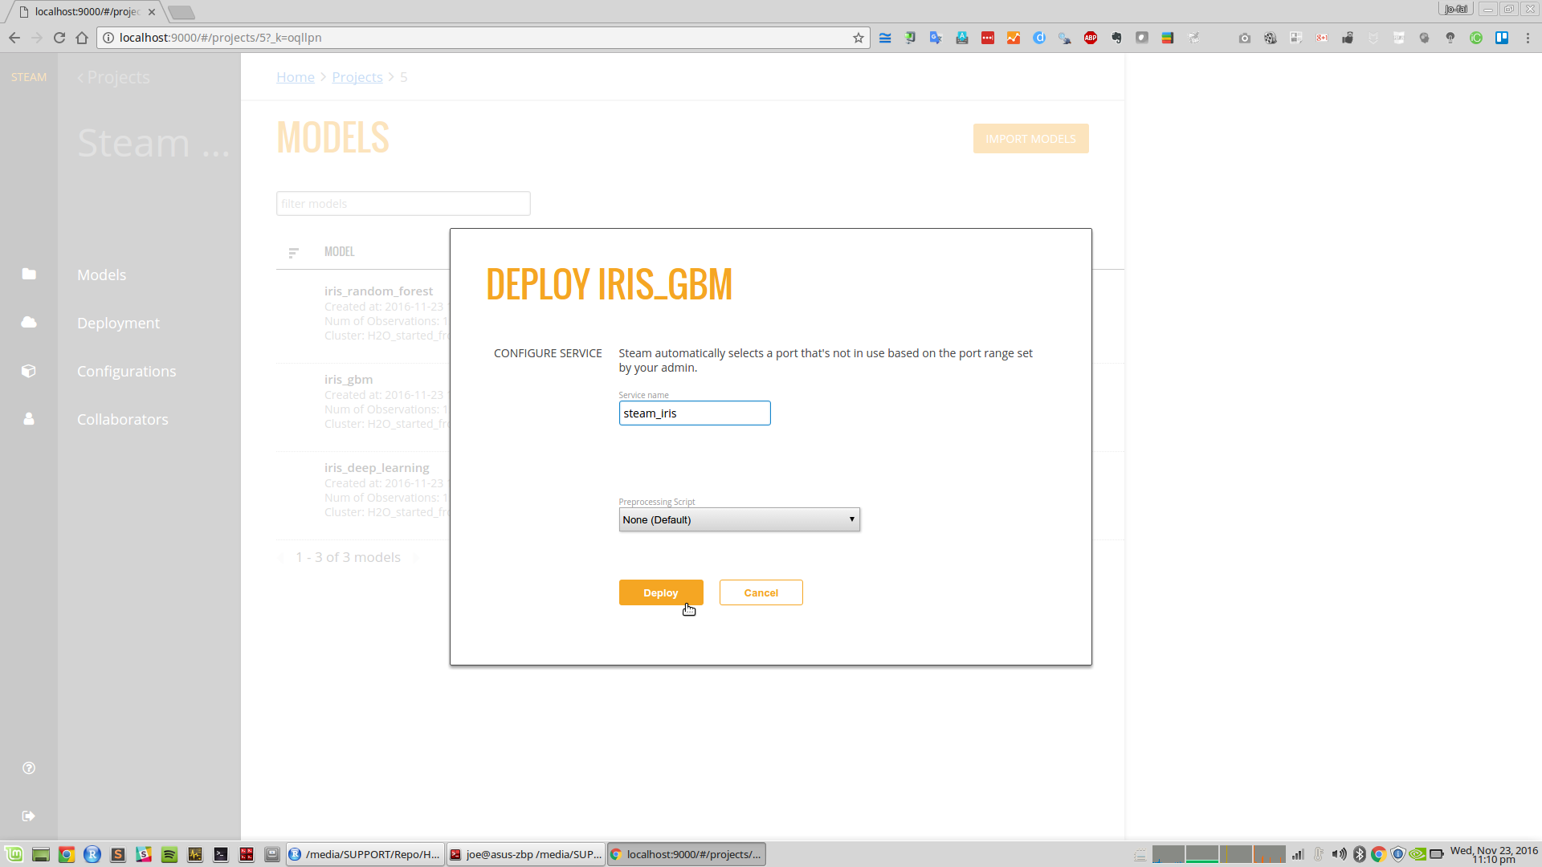

Slide 61
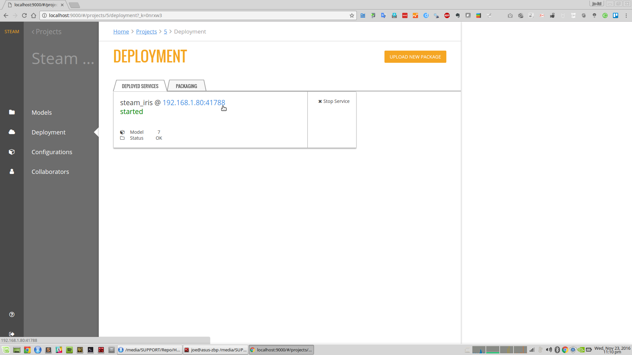

Slide 62
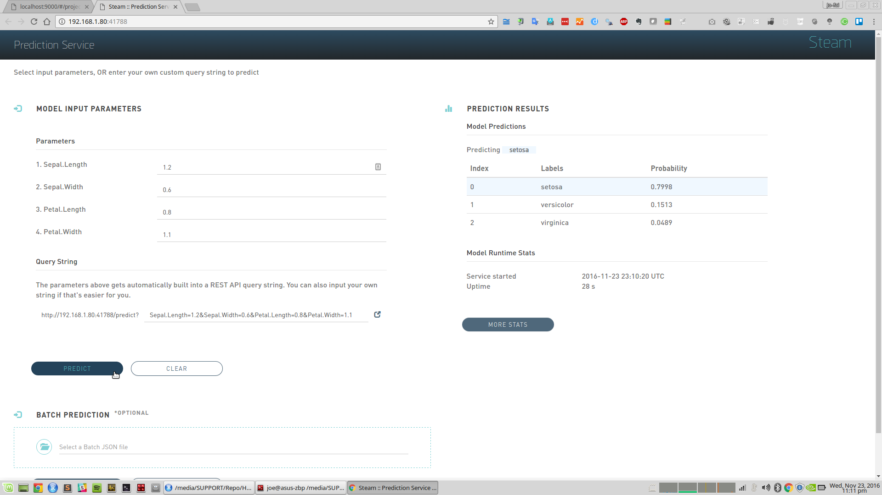

Slide 63
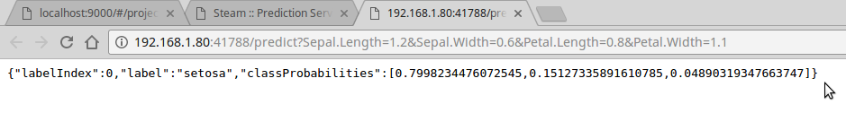
The Classic REST API Service

Slide 64
Thanks!
Organisers & Contributors
Ajit Jaokar
Sibanjan Das
Key Resources
docs.h2o.ai
github.com/h2oai/h2o-meetups
Slides & Code
bit.ly/ h2o_iot_workshop1
Contact
joe@h2o.ai
@matlabulous
github.com/woobe

